Slide 1
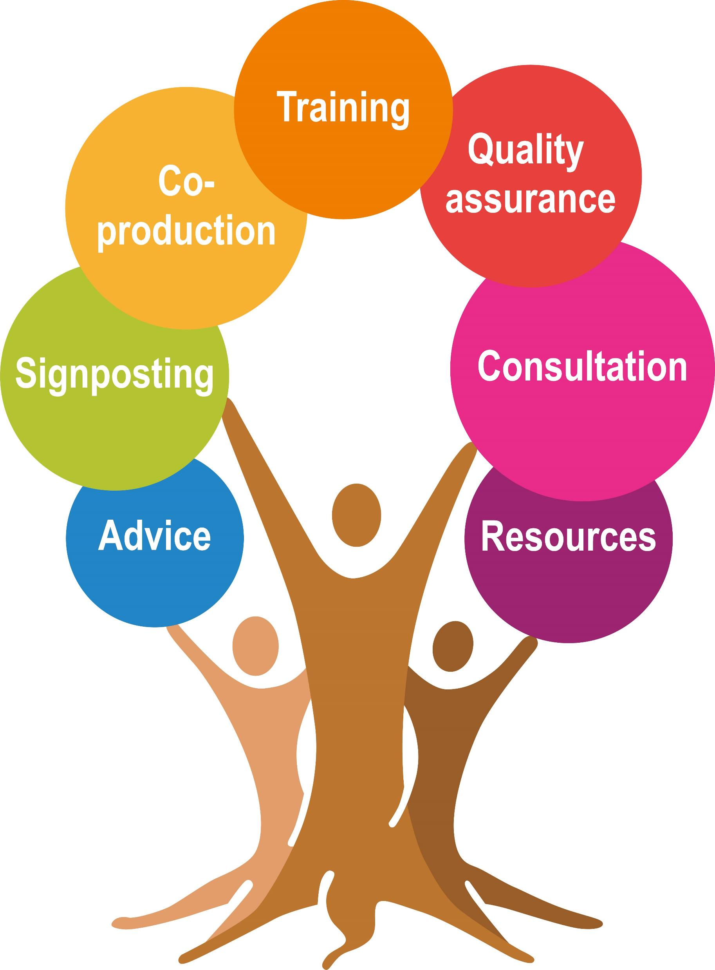
Understanding and responding to challenging Behaviour
Lauren Burns & Sarah Lee
Tackling Emerging Threats to Children Team
Nottinghamshire County Council

Slide 2

Before we begin
We are not behaviour specialists or experts
We work at the prevention end of the spectrum
Our knowledge is rooted in our own experiences of parenting as well as the latest research
We don’t have all the answers
This workshop will be a sharing of all our minds and possible solutions
We will signpost to sources of help and support

Slide 3
What are your best hopes for this session? Why are you here?

Slide 4






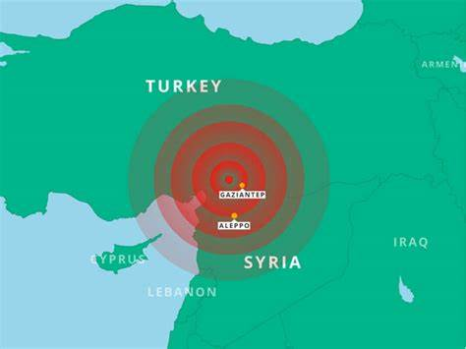
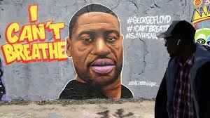


Slide 5
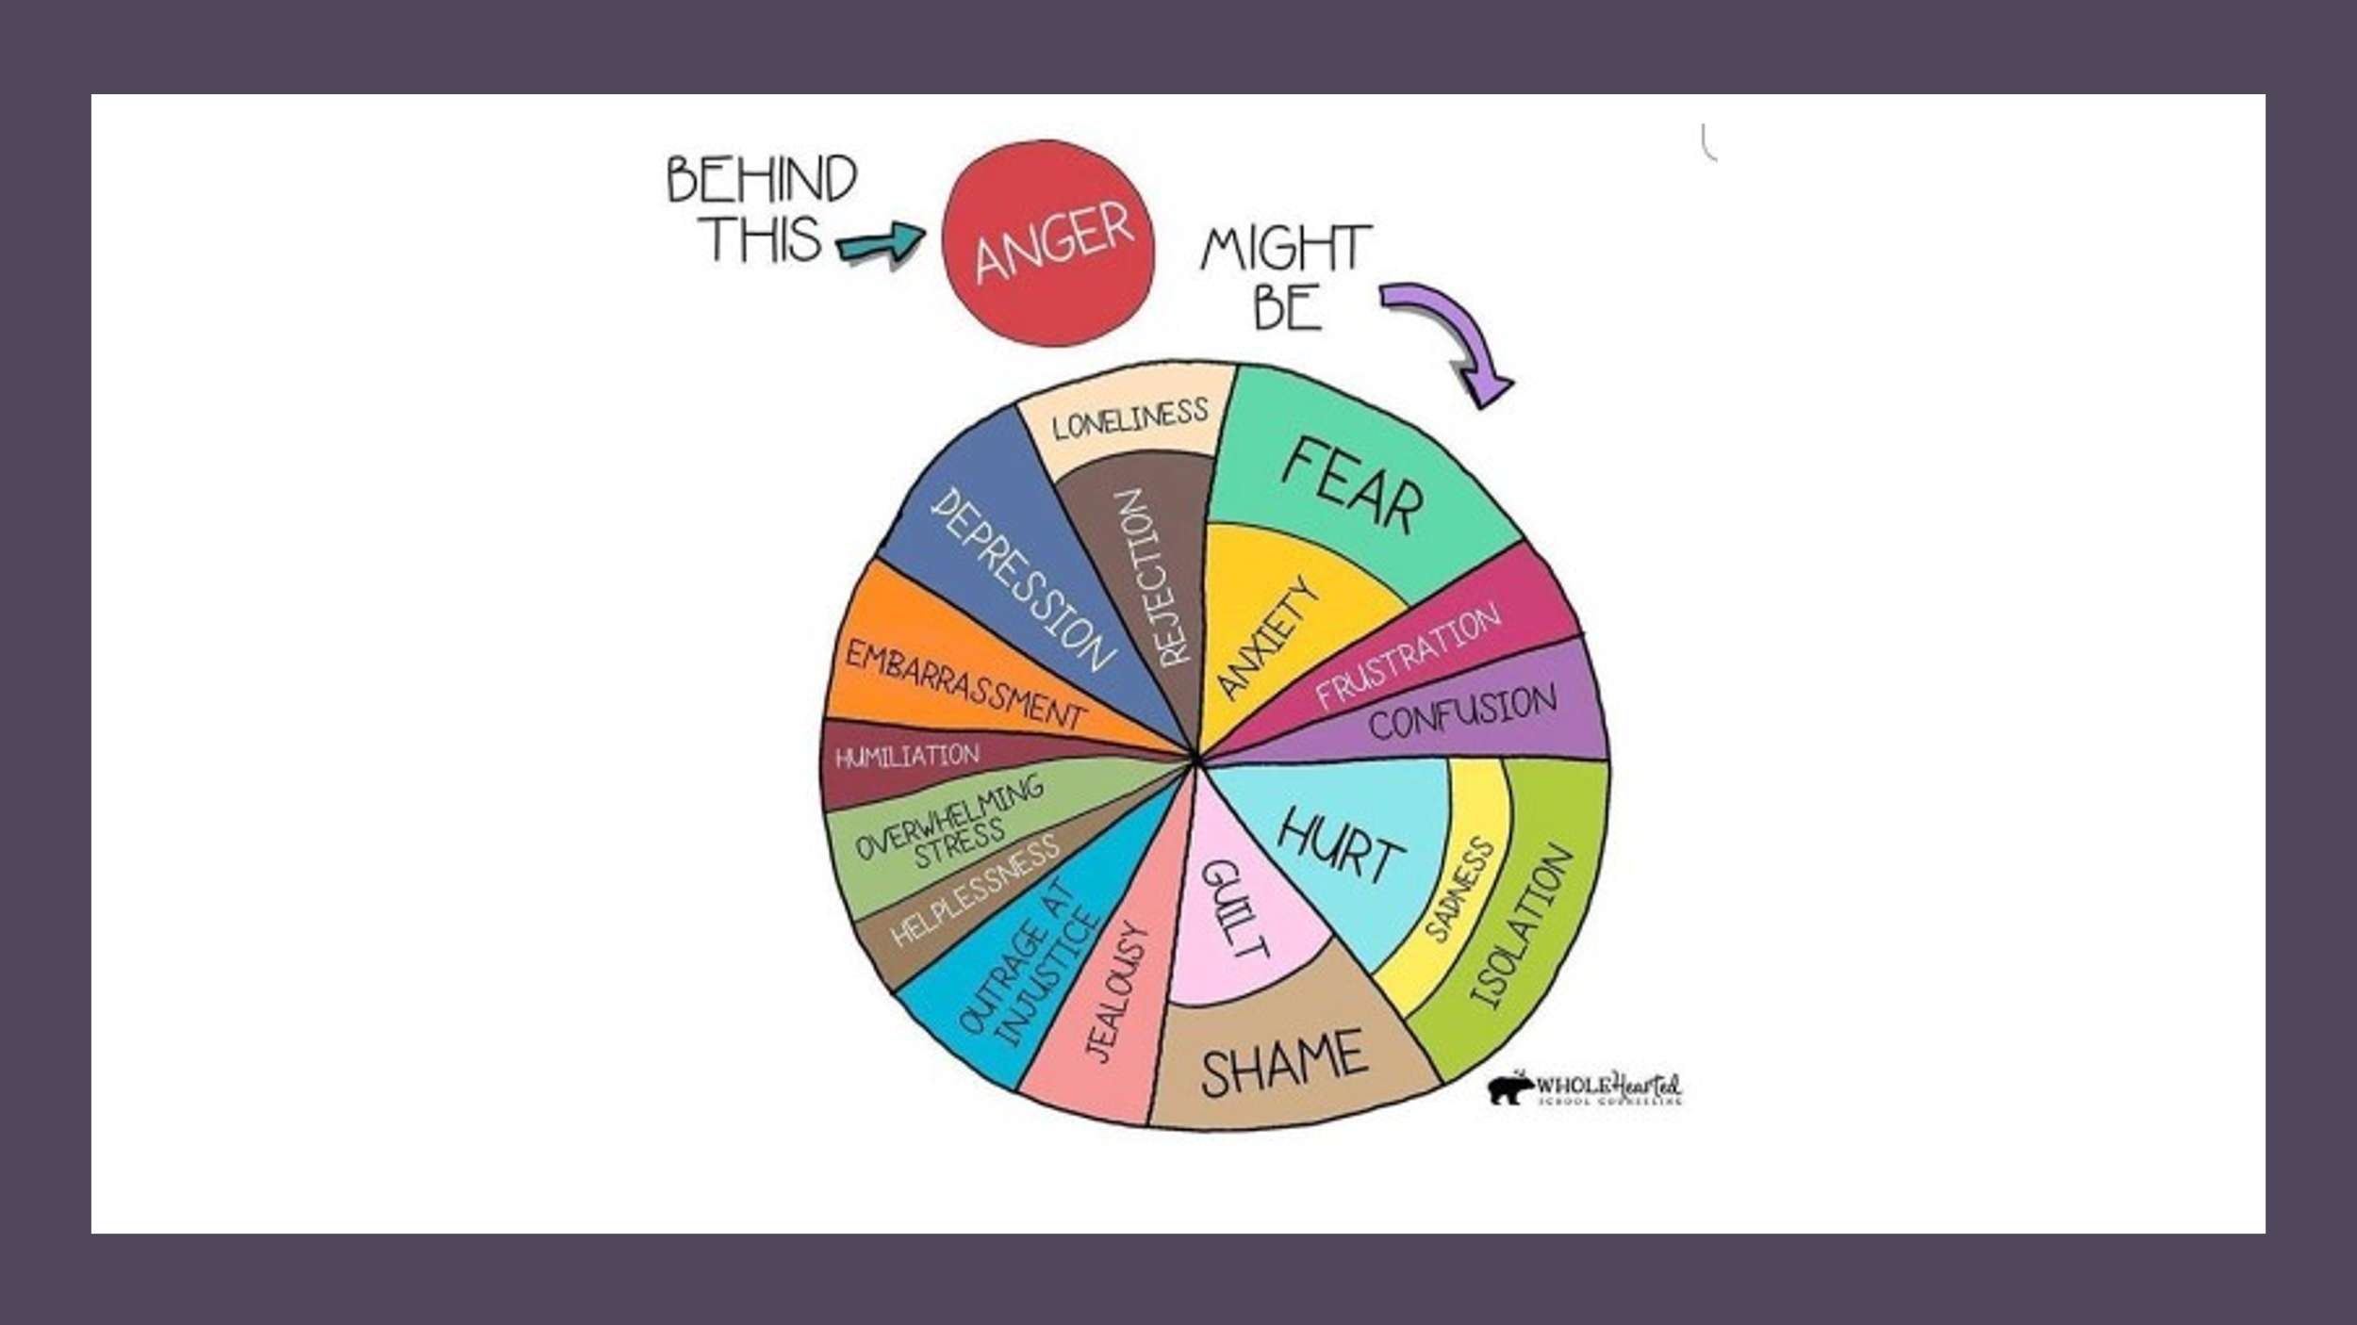
Understanding behaviours
Behaviours are a communication of our emotions
Through our relationships with others, we learn to understand our experiences and regulate our emotions

Slide 7
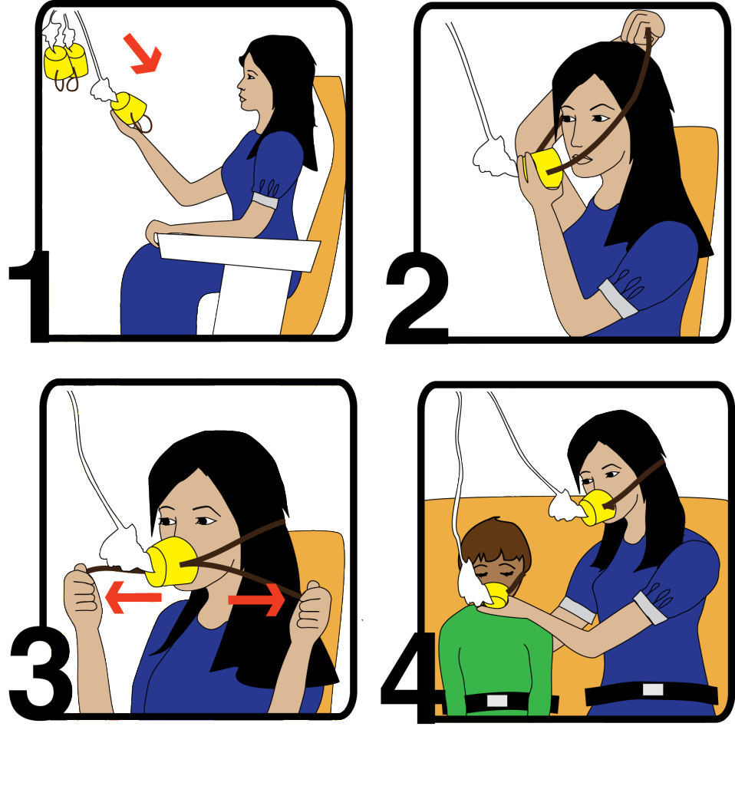
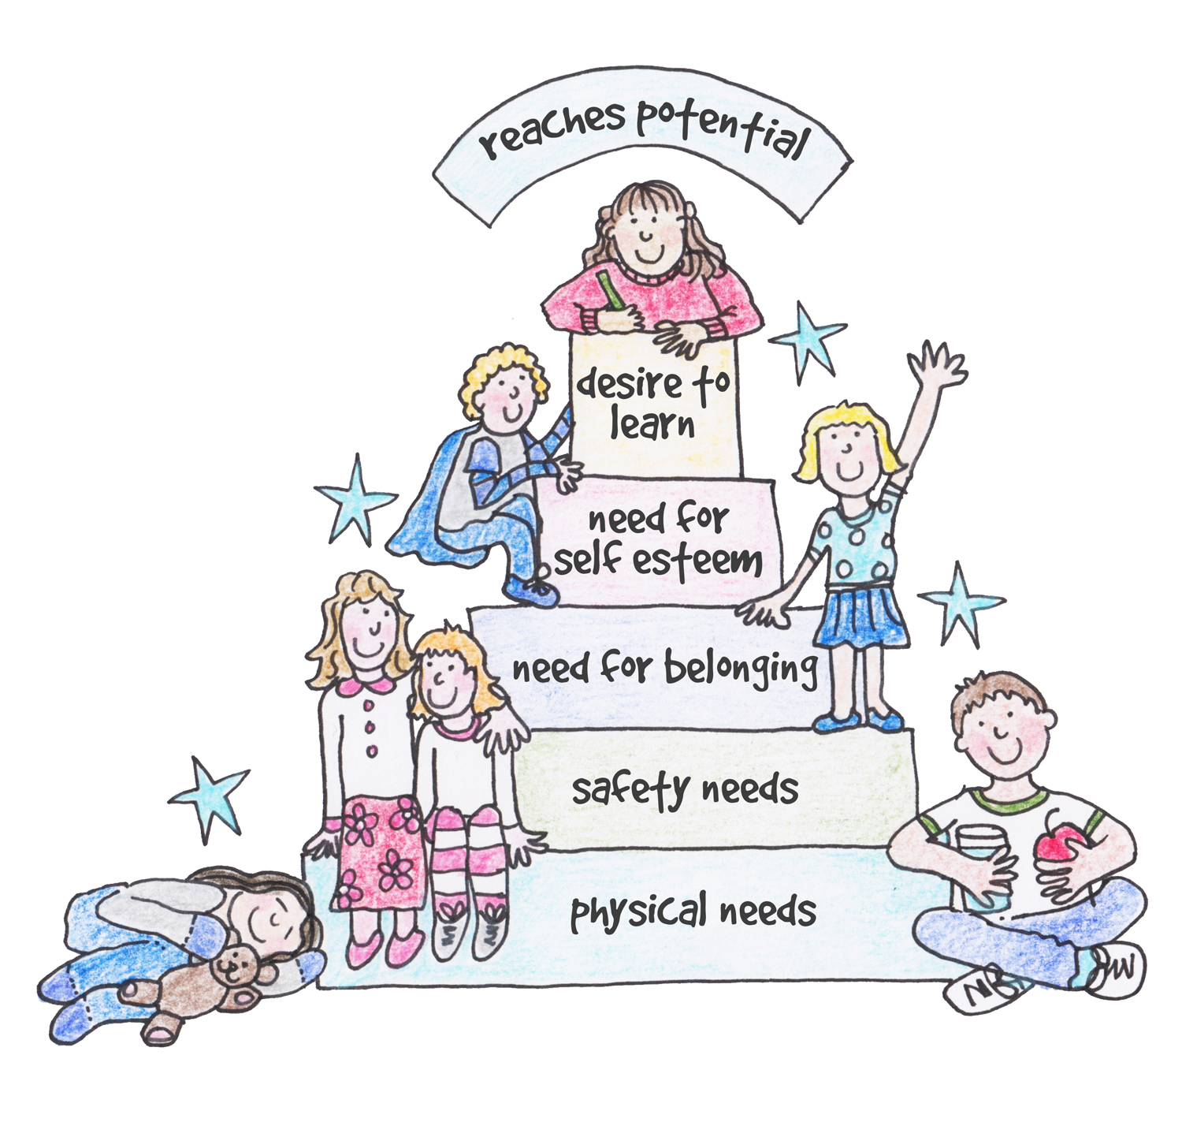

Slide 8


Slide 11
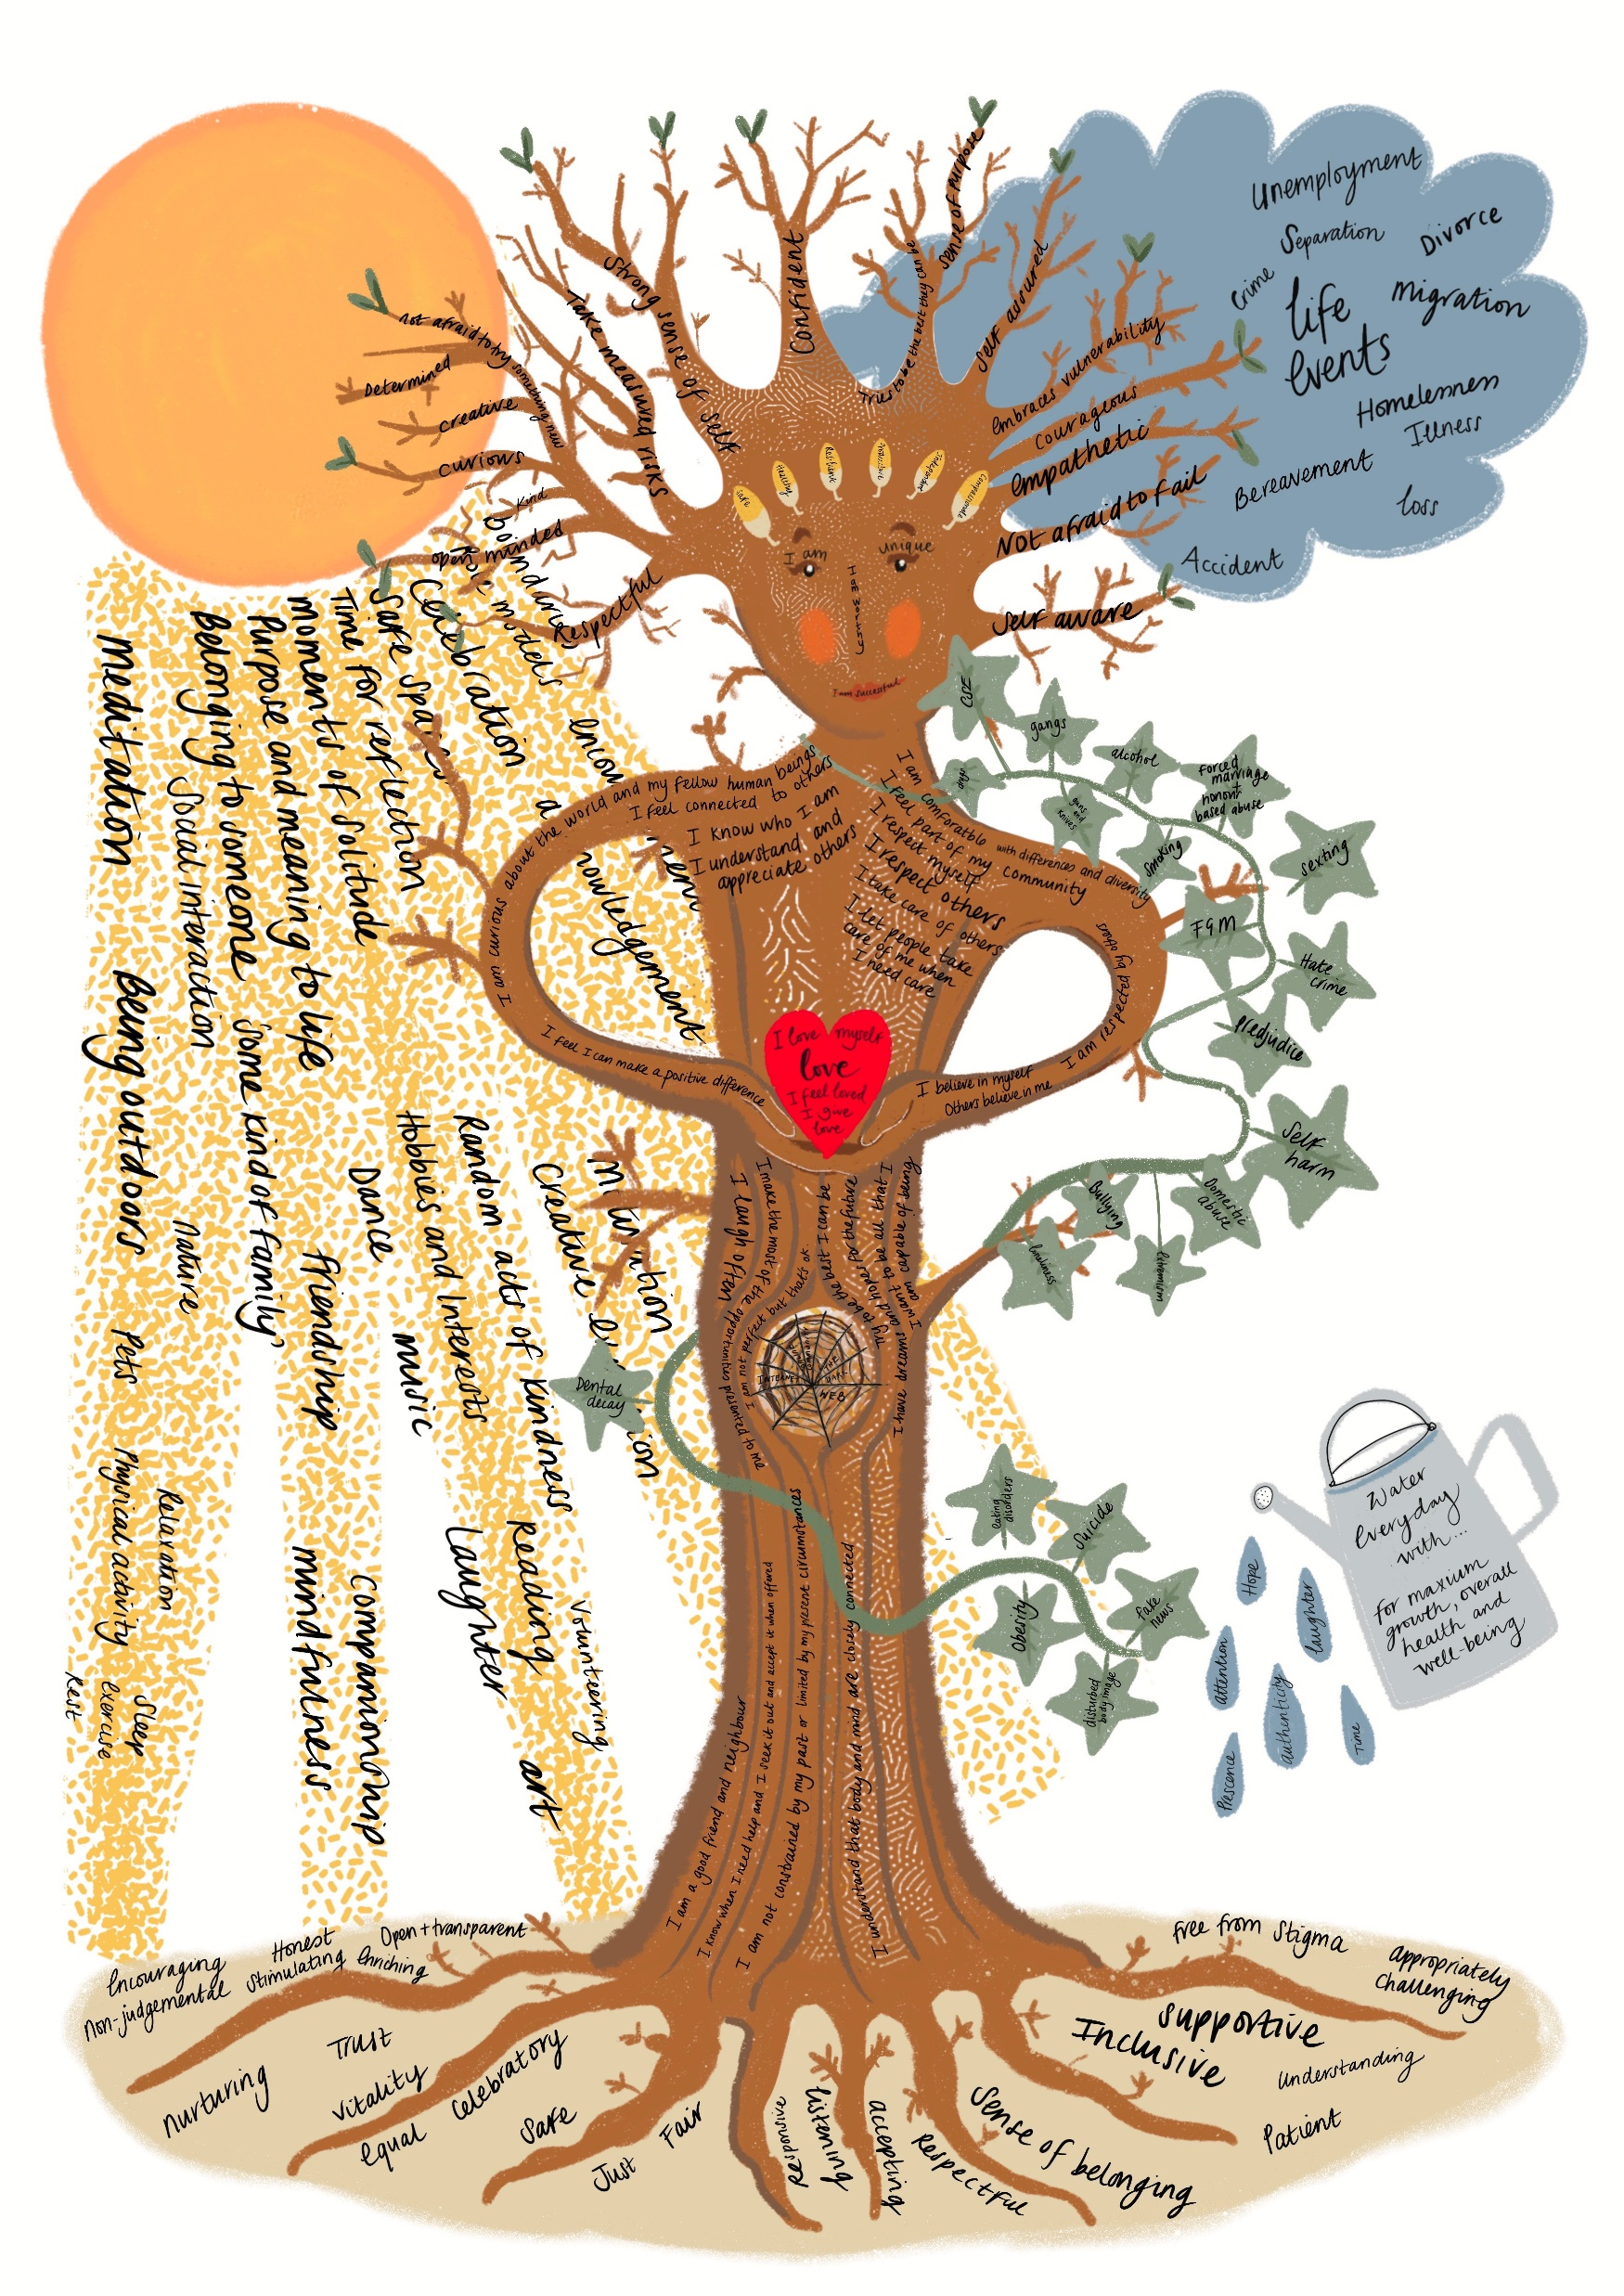
Parenting- small group discussion-
how were you parented and how
has this influenced your own parenting
style?

Slide 13


Slide 14
Why do Emotion Coaching?
Children are better able to:
• control their impulses
• delay gratification
• self soothe when upset
• pay attention
Gottman et al.(1996, 1997)
Emotion Coaching is an Evidence-based Strategy based upon the work of John Gottman
Emotion Coached Children:
✓ Achieve more academically in school
✓ Are more popular
✓ Have fewer behavioural problems
✓ Have fewer infectious illnesses
✓ Are more emotionally stable
✓ Are more resilient
Can you think of a different way to deal with your feelings?
Let's see if we can think together about new ways to do this
I can help you to think of a different way to cope
Can you remember what we said before?

Slide 15
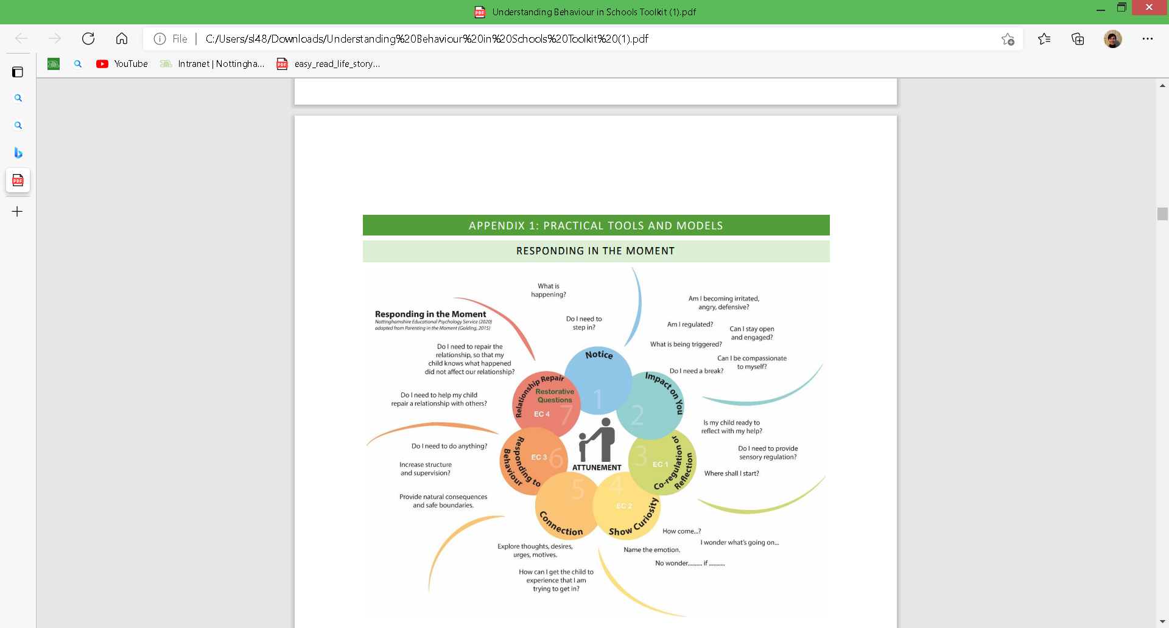

Slide 16
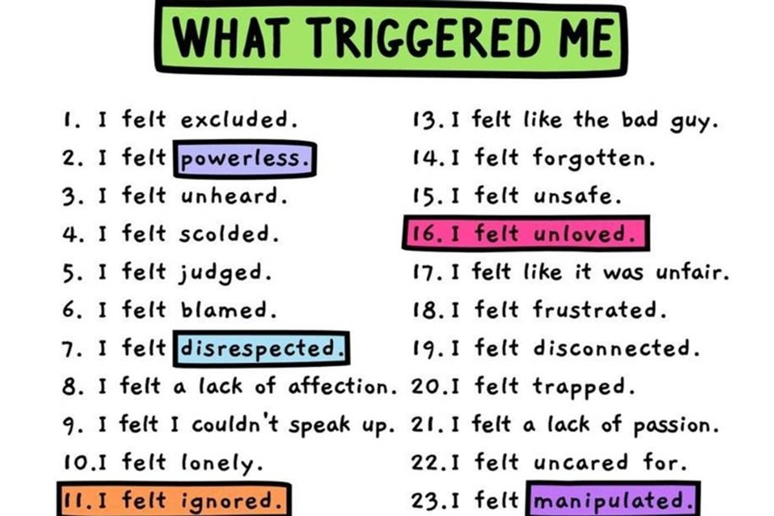
The power of self-reflection and awareness

Slide 17
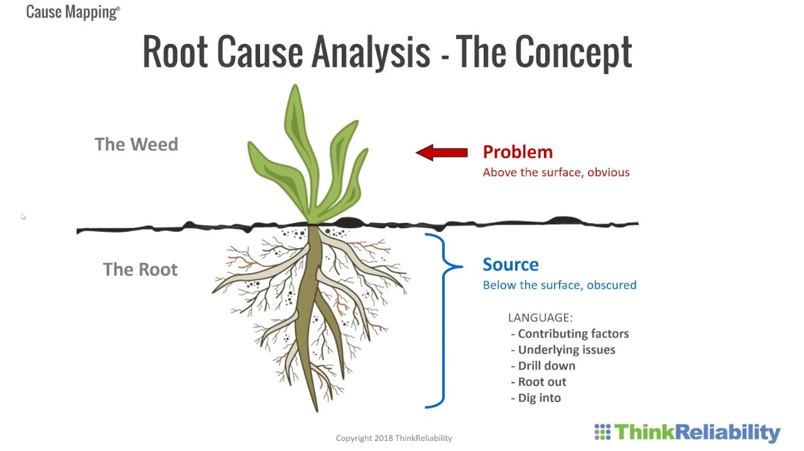
Solution focused approaches

Slide 18
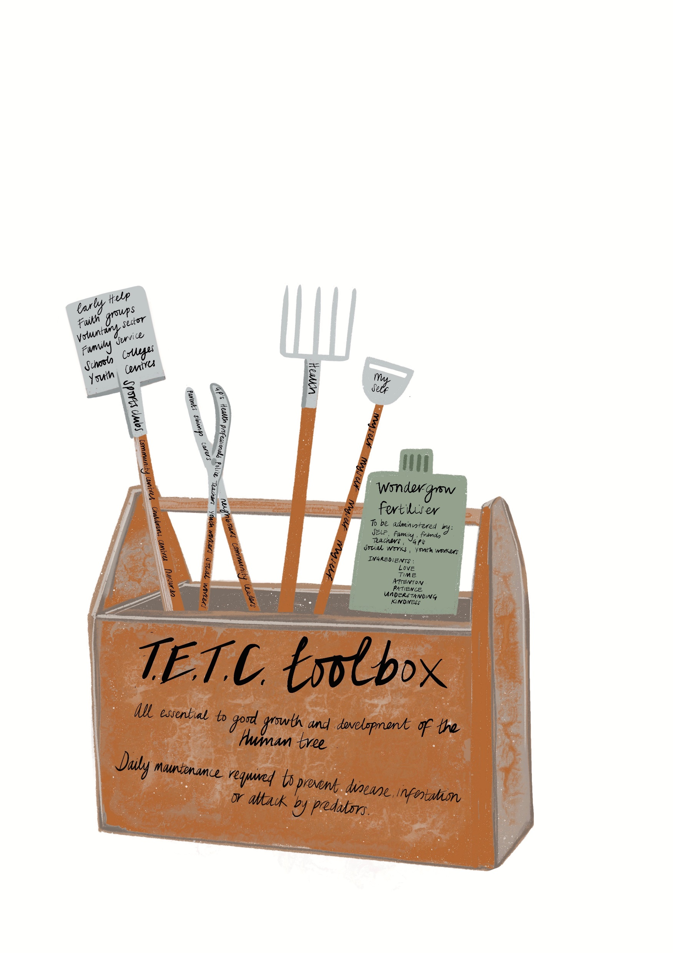
Time to help each other out
Describe a scenario you regularly face/the situations you find most challenging
Consider what emotions might be triggered for you/your child in this situation
Consider what your usual response is and how effective it is
Thinking about what we have discussed already, as a group try to come up with a range of strategies you could employ which might be more effective
If you can’t think of any, note what the barriers are to finding a solution

Slide 19
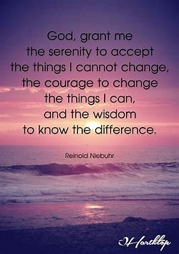
The power of calm
“Calm is an intention. Do we want to infect people with more anxiety, or heal ourselves and the people around us with calm?”
Brene Brown
“Intensity and reactivity only breed more of the same. Calm is also contagious. Nothing is more important than getting a grip on your own reactivity.”
Harriet Lerner

Slide 20
The 5c’s and the 3 R’s
Calm
Communication
Consistency
Compassion
Courage

Slide 21
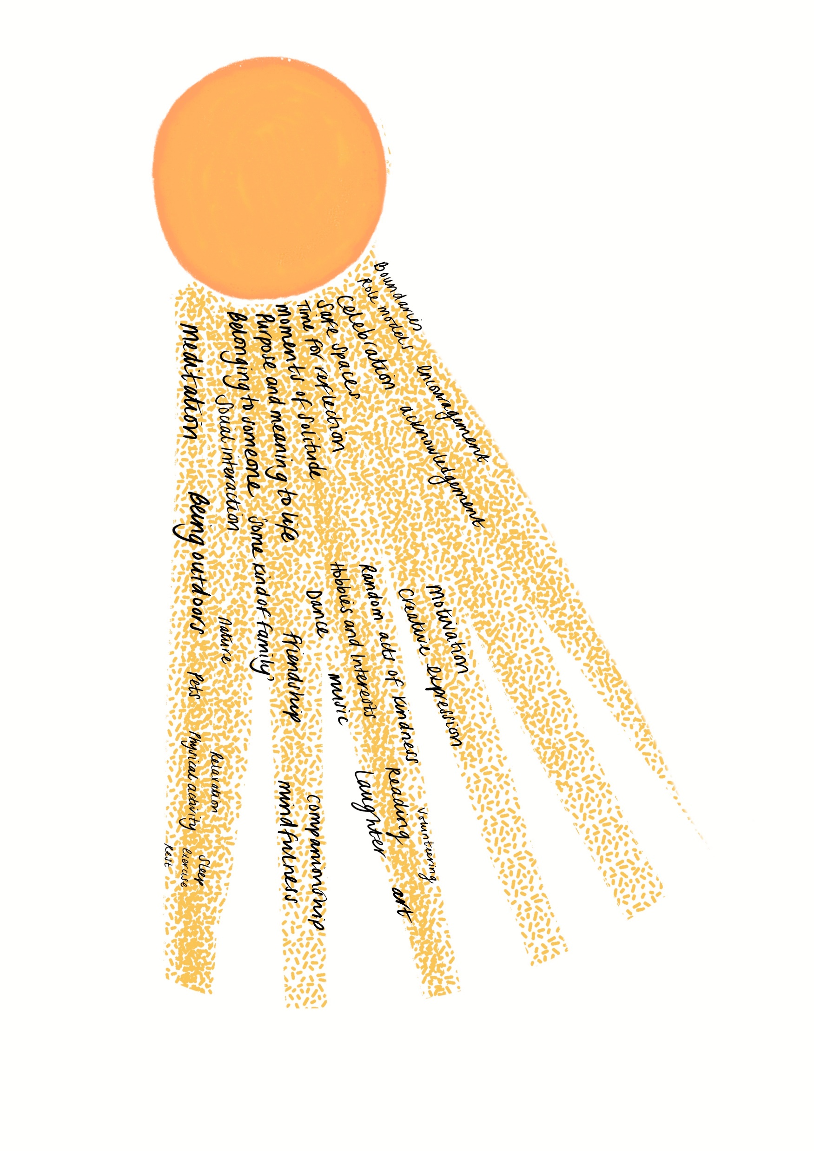
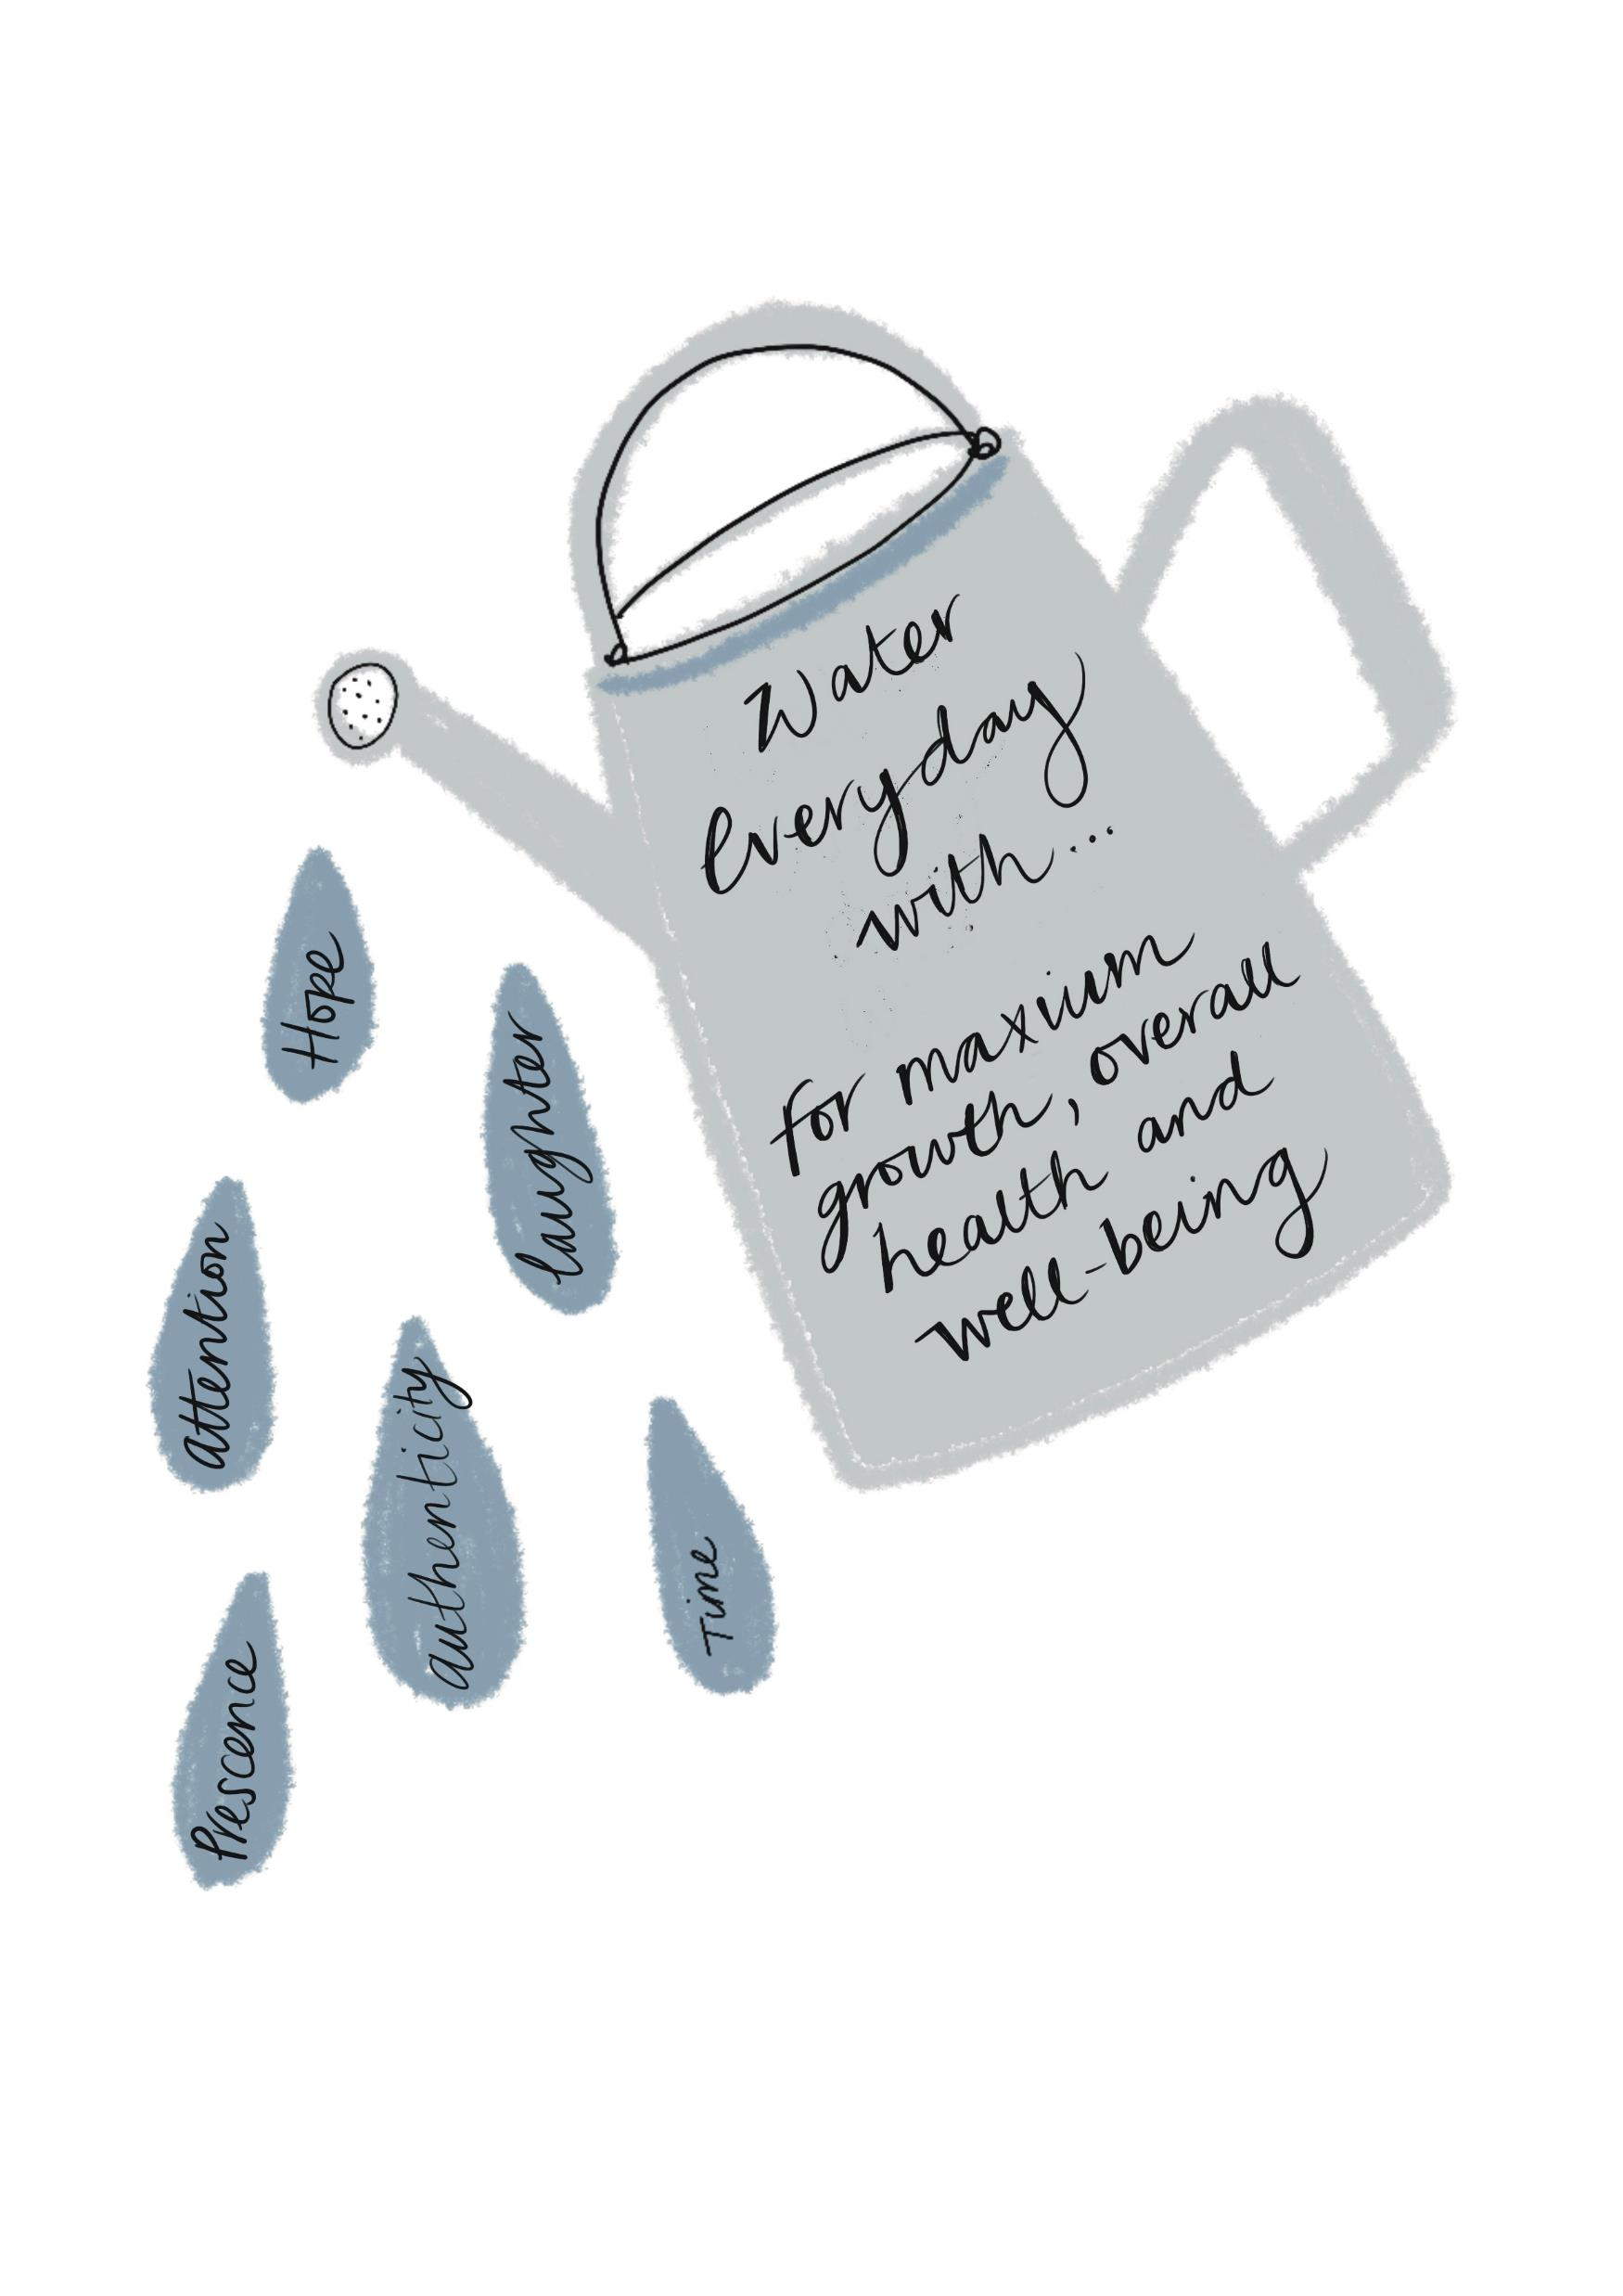

Slide 22
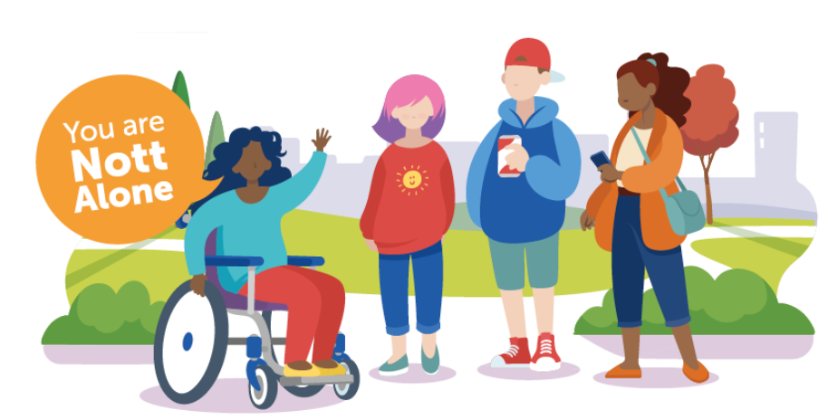
Resources to Help
NottAlone – Local website ‘one stop shop’ for mental health information and support. Website can be adapted in view for young person, parents/carers and professionals.

Slide 23
Useful websites/links
5 Incredibly Fun GAMES to Teach Self-Regulation (Self-Control) | Social Emotional Learning – YouTube
Some Days I Flip My Lid - Read-aloud with reflections and mindful breathing – YouTube
Zones of Regulation: The Red Zone – YouTube
Zones of Regulation: The Yellow Zone – YouTube
Zones of Regulation: The Green Zone – YouTube
Zones of Regulation: The Blue Zone - YouTube
Hot Chocolate Breaths Breathing Activity for Kids – YouTube
Learn To Bring Down Stress | Guided Meditiation For Kids | Breathing Exercises | GoNoodle – YouTube
Mindfulness Meditation for Children | SOFT BELLY BREATHING | Guided Meditation for Kids – YouTube
Guided Meditation for Kids | Spaceship to the Moon | Relaxation for Children – YouTube
Mindful Moment #2: Five Finger Breathing – YouTube
The 5-4-3-2-1 Method: A Grounding Exercise to Manage Anxiety - YouTube
A JAPANESE METHOD TO RELAX IN 5 MINUTES – YouTube
Change your negative nerves into positive energy - BBC - YouTube

Slide 24
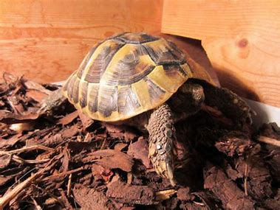
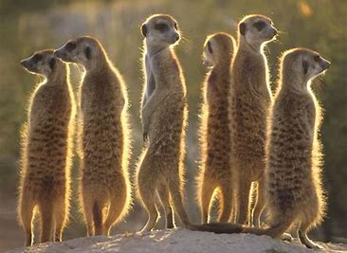
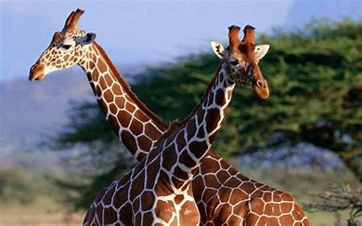
Take Time …
To make sure you NOTICE (identify and name the emotions)
To CONNECT (people and places = joy)
To use your INSIGHT (what do I know works)
WAIT AND BREATHE (when your own anxiety/emotions are rising)
To REFLECT (why am I/why is my child feeling this way and what can I/ can’t I control)
For YOURSELF- (do the things you enjoy and which enrich your life, sleep, learn to relax, pay attention to what you eat, get active, have fun)
To RECOGNISE when you need help and support and ASK and ACCEPT it when required

Slide 25
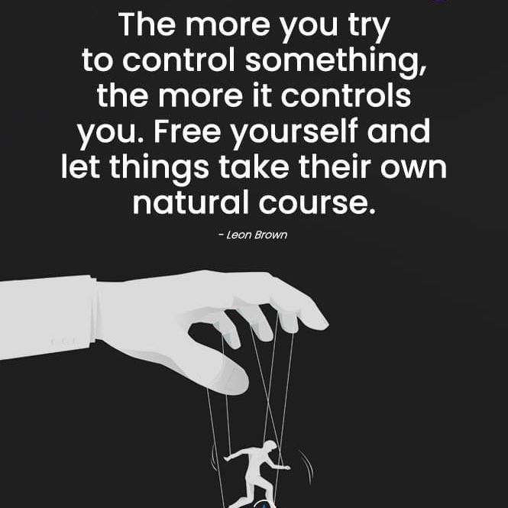

Slide 26

Contacts:
Sarah Lee
sarah.lee@nottscc.gov.uk
Tel: 0115 854 6089
Mob: 07903 266718
Lauren Burns
Lauren.burns@nottscc.gov.uk
Tel: 0115 854 6336
Mob: 07904 594939

