Slide 1
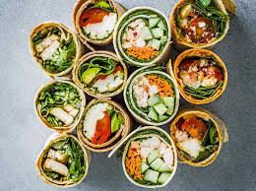
DT 12.2.21
LO: I can evaluate my healthy wrap

Slide 2
To make your wrap, you will need to:
Look at your design sheet from last week and buy the ingredients you have chosen
Make sure an adult is with you before you begin preparing your wrap
Wash your hands carefully before handling your ingredients
Grate or slice your ingredients with the support of an adult.
Place your ingredients onto you wrap and roll it (an adult can help with this)
Eat and taste your wrap!
Go to the next slide and complete the taste evaluation form

Slide 3
