Slide 1
The Foundation Stage Curriculum
Abbey Road School

Slide 2
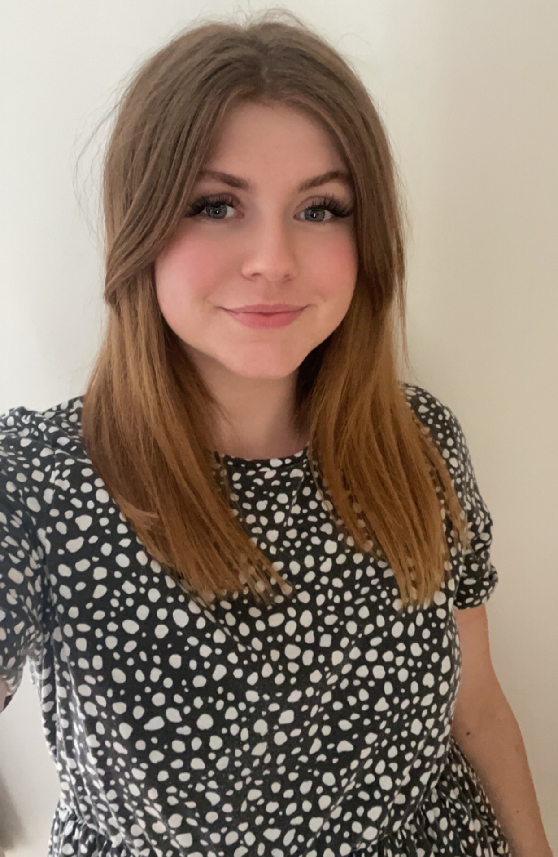
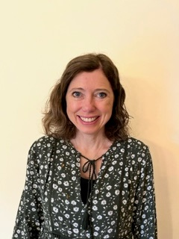


Reception Teachers
Miss Long
Rainbow class
Mrs. Smith
Sunshine Class

Slide 3
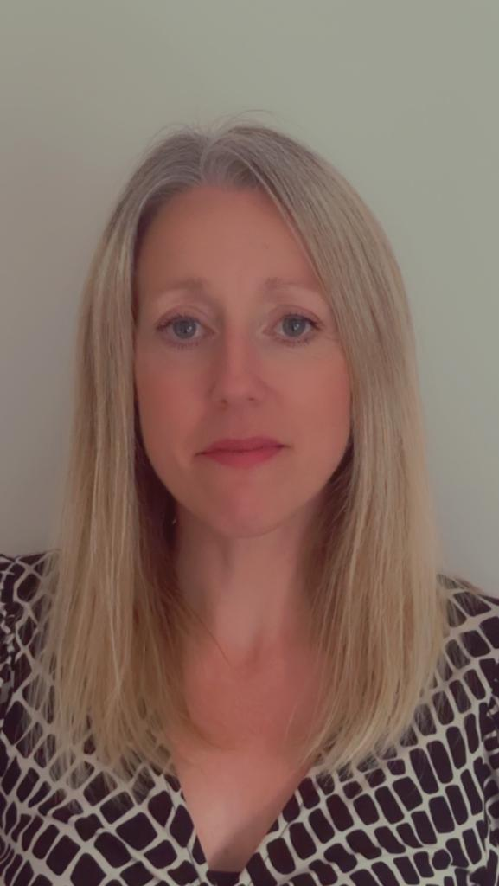
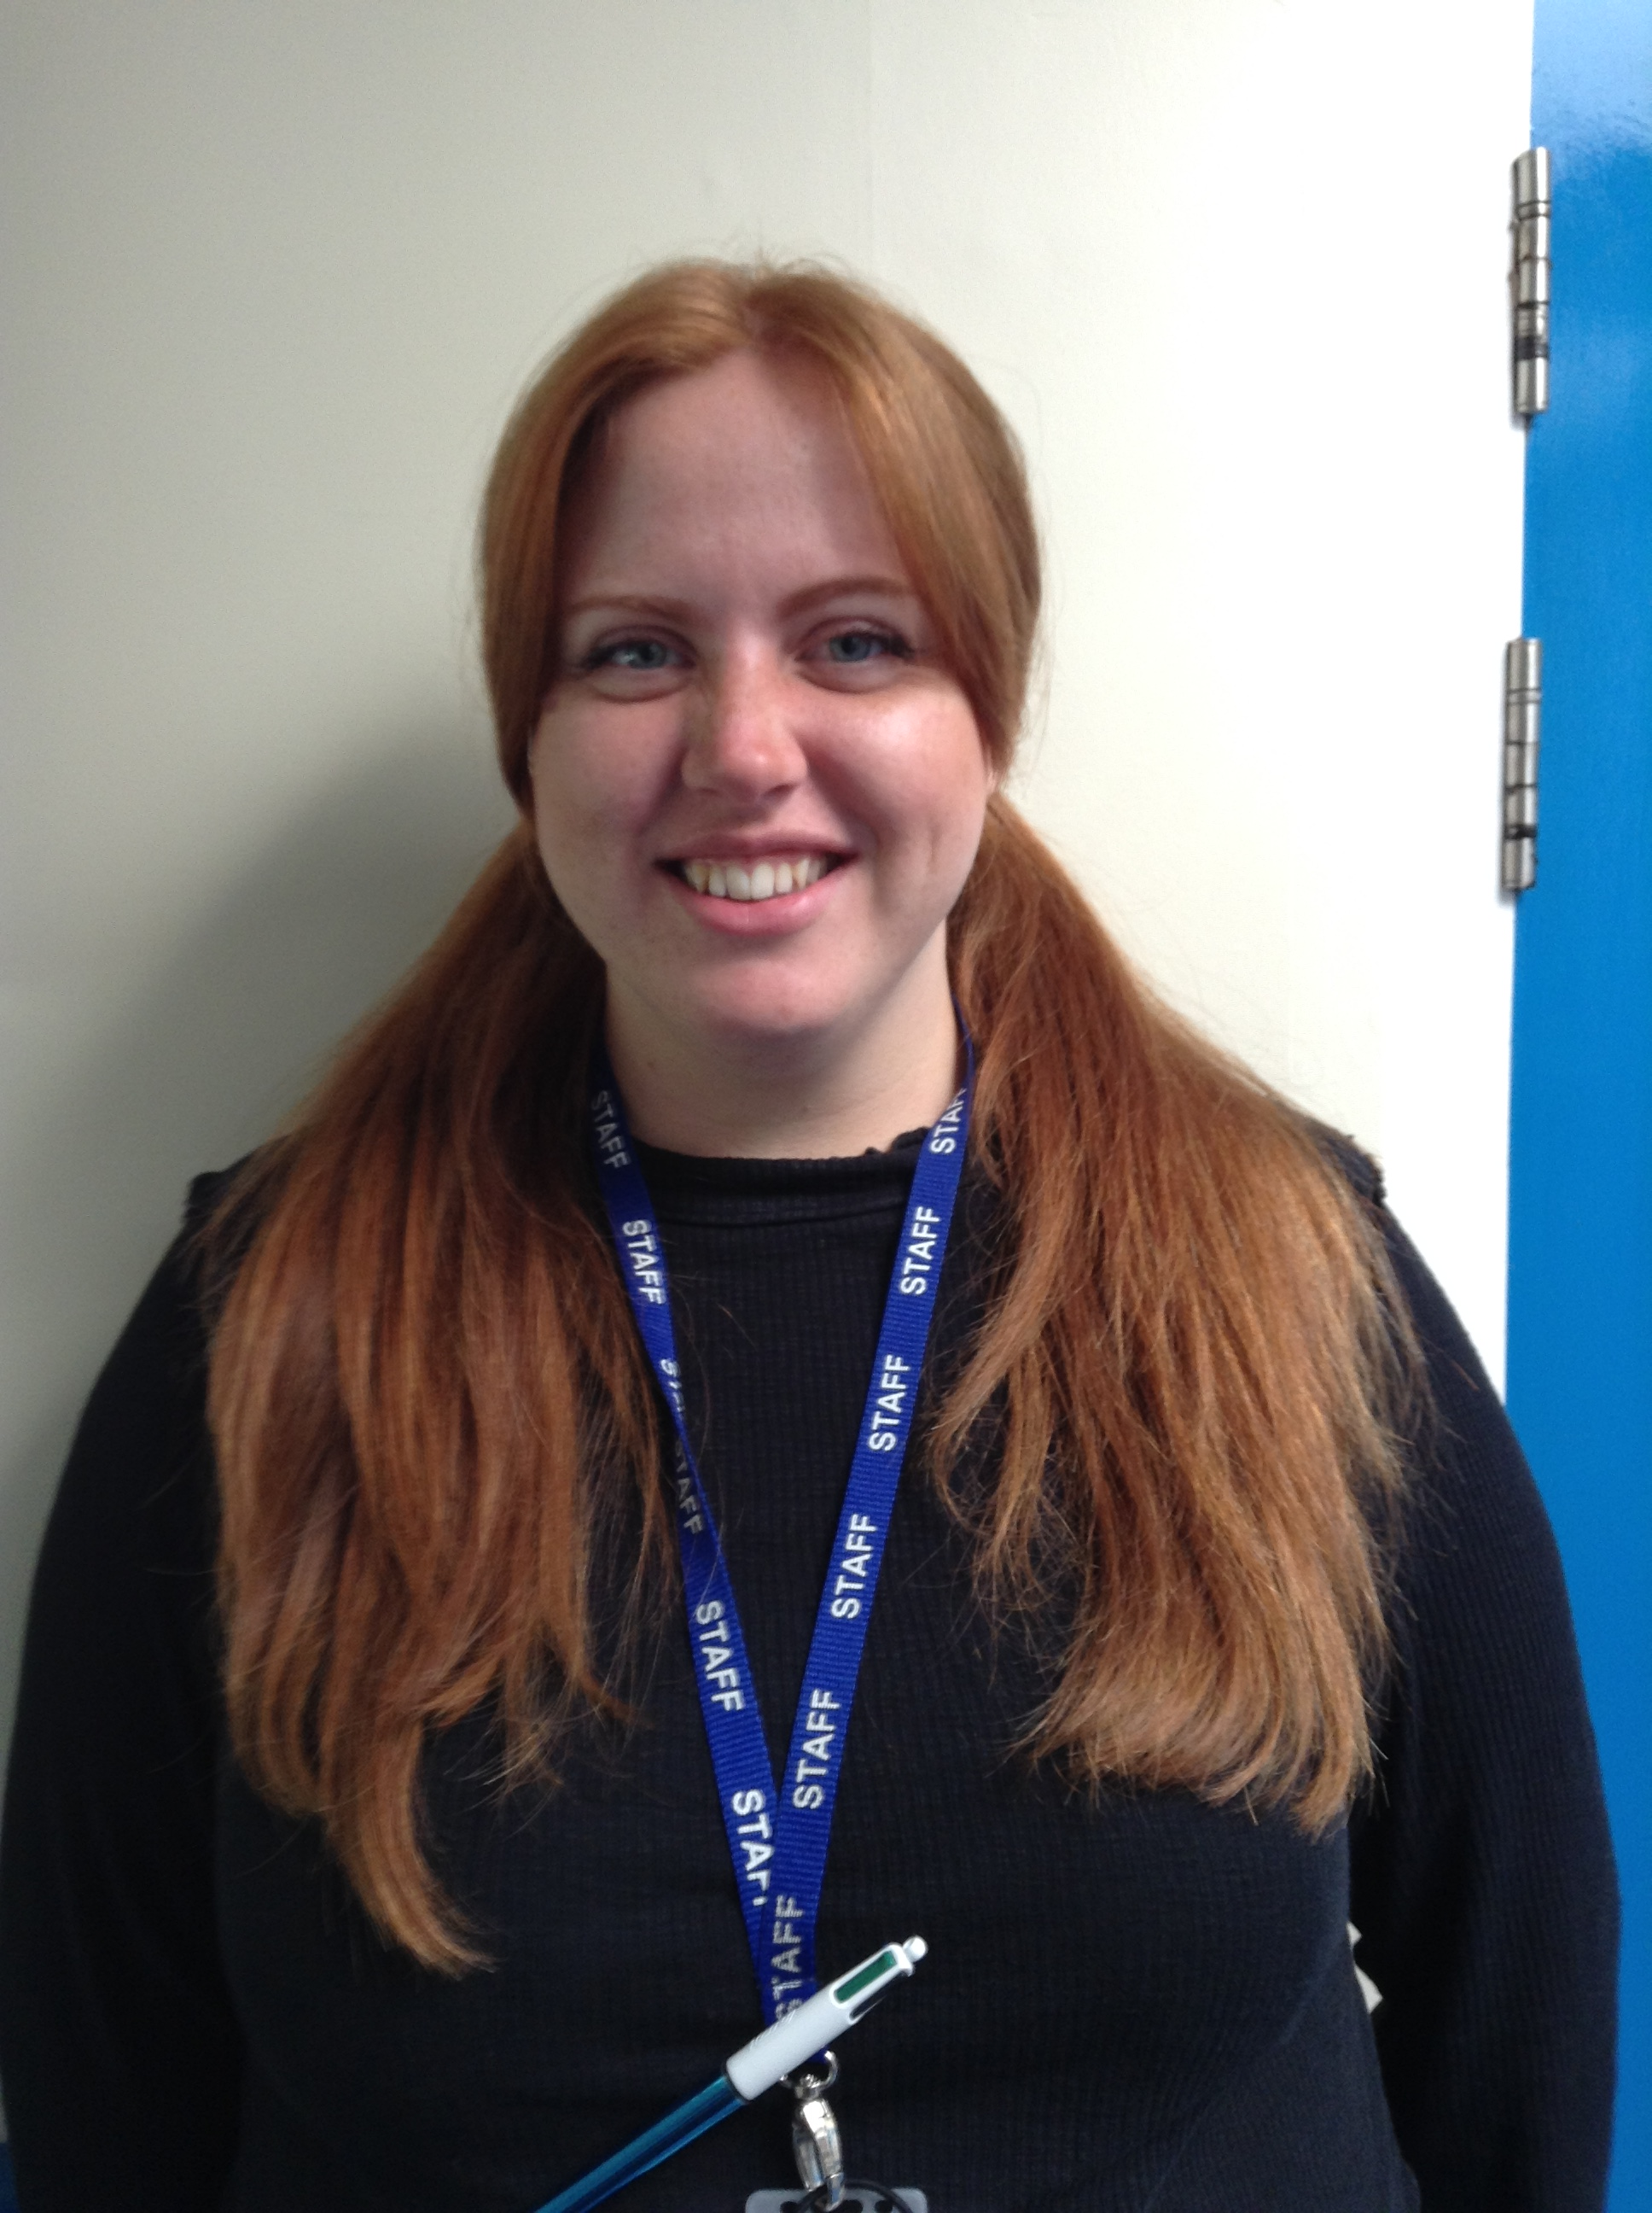
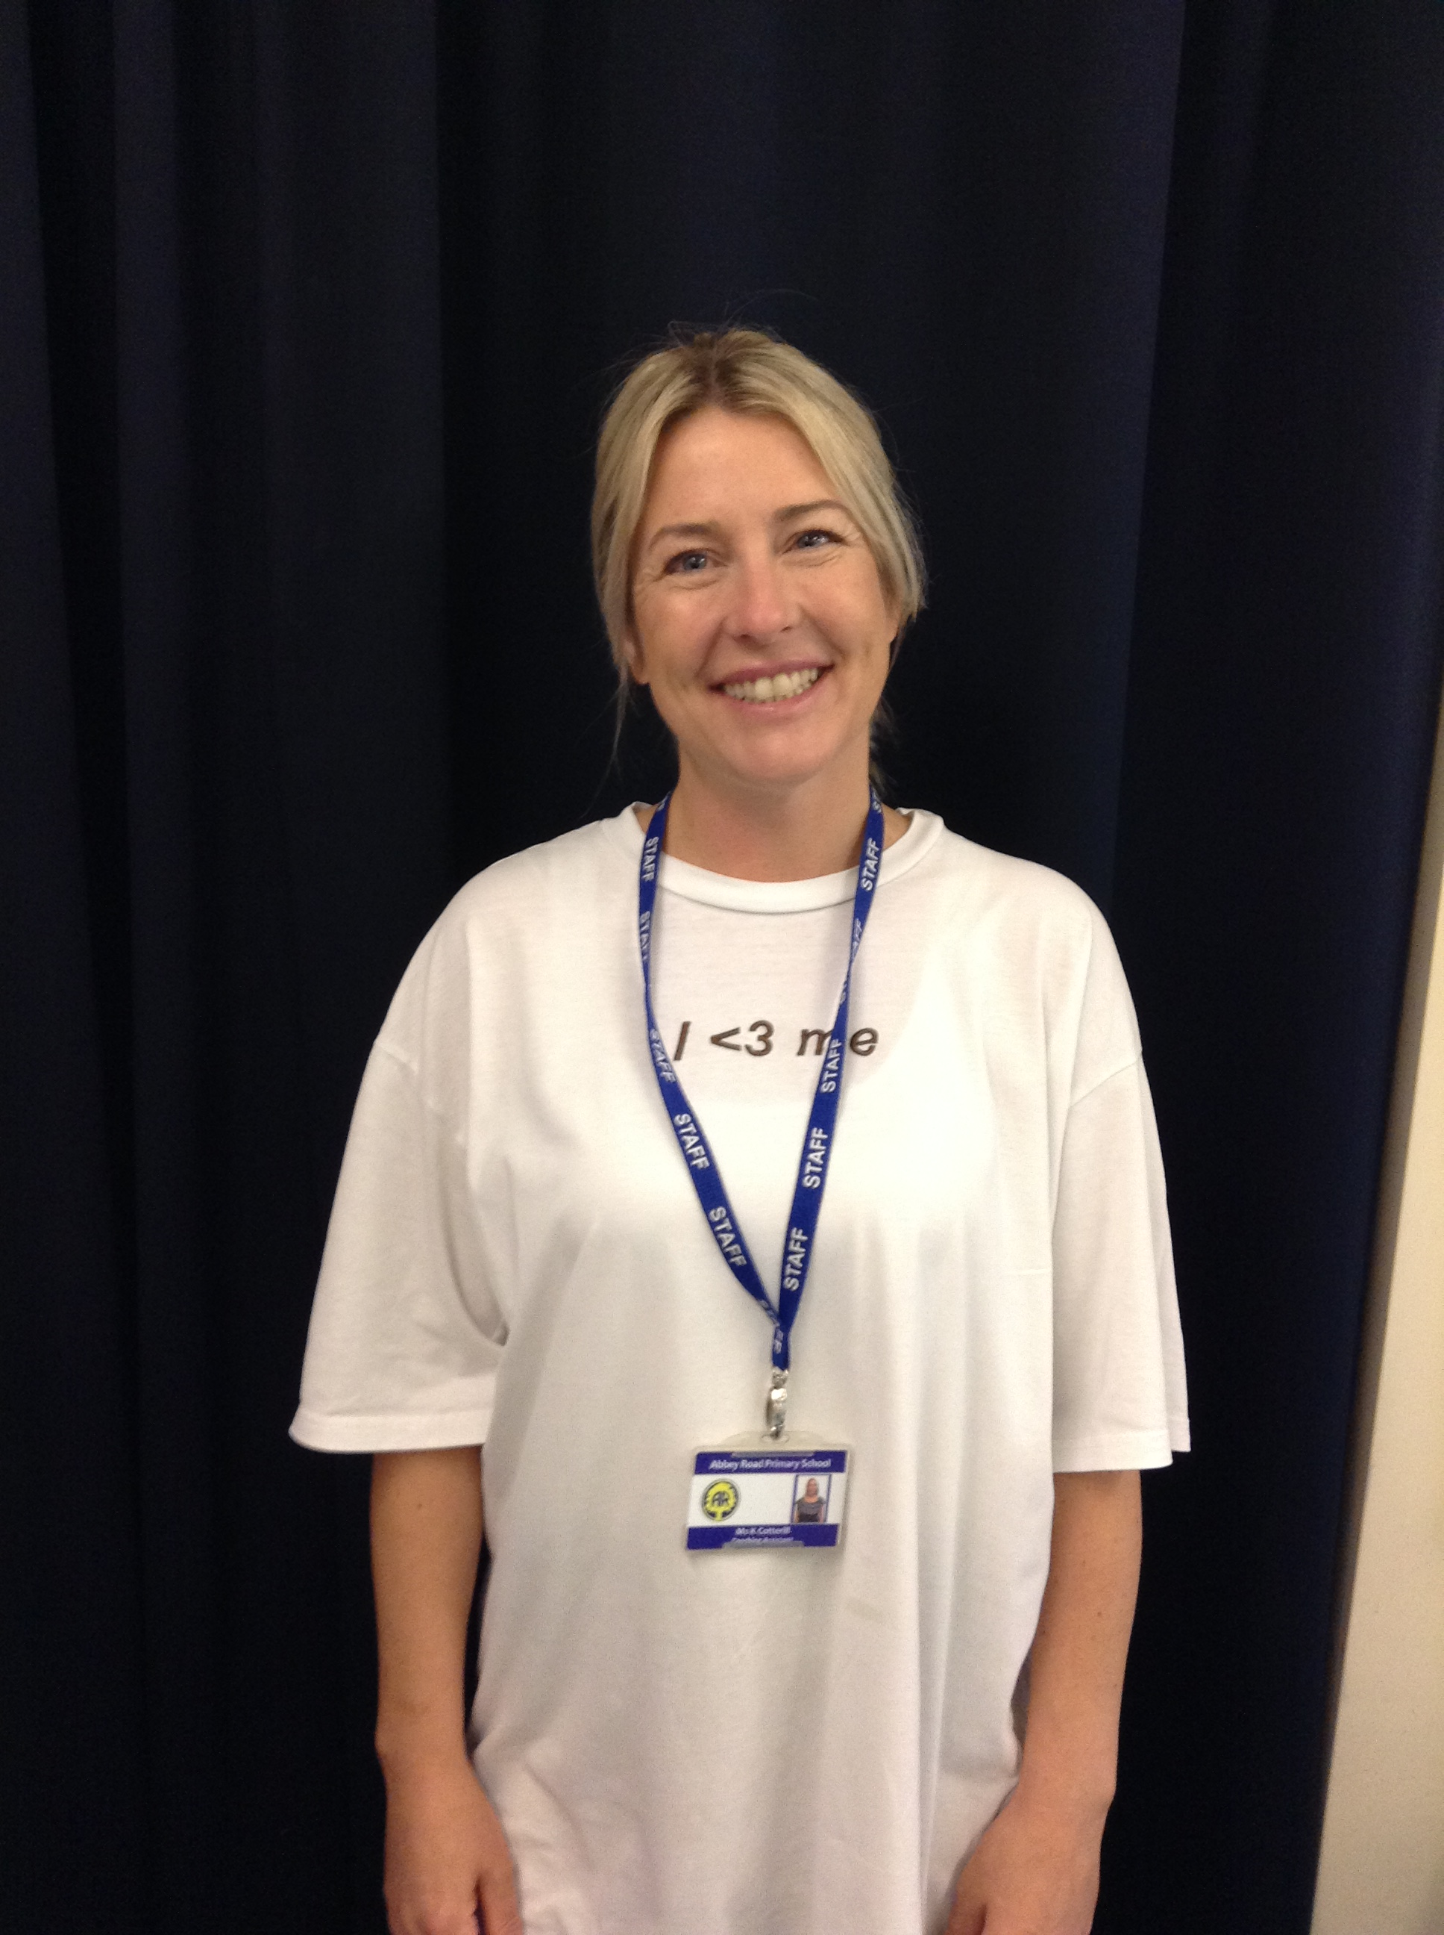
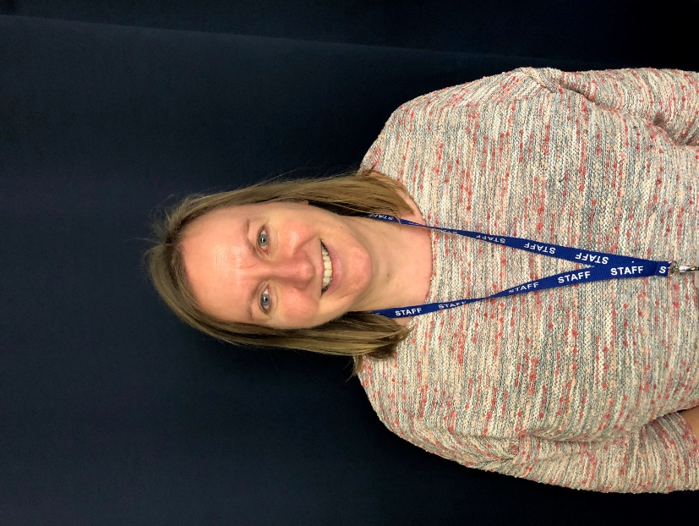
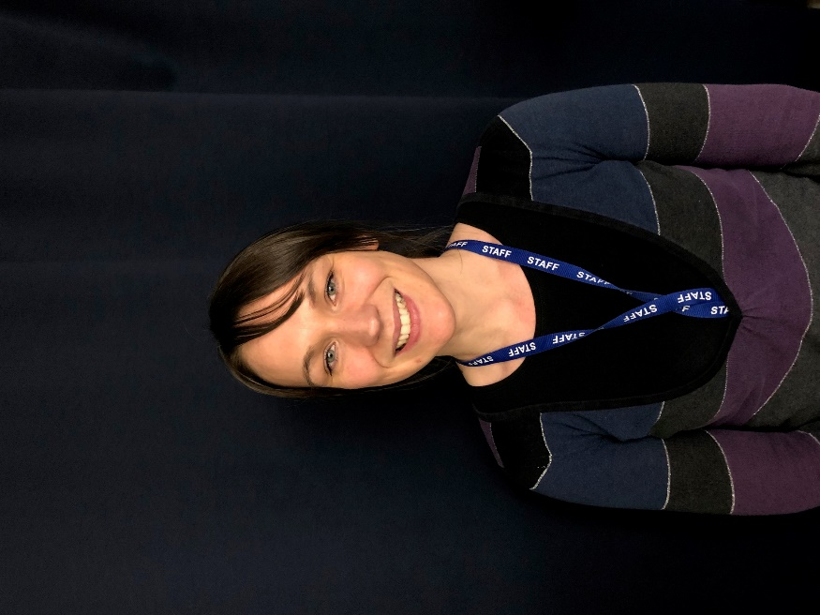
Foundation Teaching Assistants
Mrs Winch
Mon-Wed
Rainbows
Mrs Sewart
Wed –Fri
Rainbows
Miss Cox Sunshines
Mrs Bakewell
Sunshines
Miss Cotteril
Rainbows

Slide 4
7 Areas of Development
3 prime areas
4 specific areas
Personal, Social and Emotional Development
Communication and Language
Physical Development
Literacy
Mathematics
Understanding the World
Expressive Arts and Design
Notes:
There are 7 areas of learning which we will help your child to develop.
Prime are important as these skills are needed to be able to do specific.
Doesn’t mean we don’t do specific until achieved Prime – as their language develops and they learn more vocab, their writing will improve.
They work alongside each other.

Slide 5
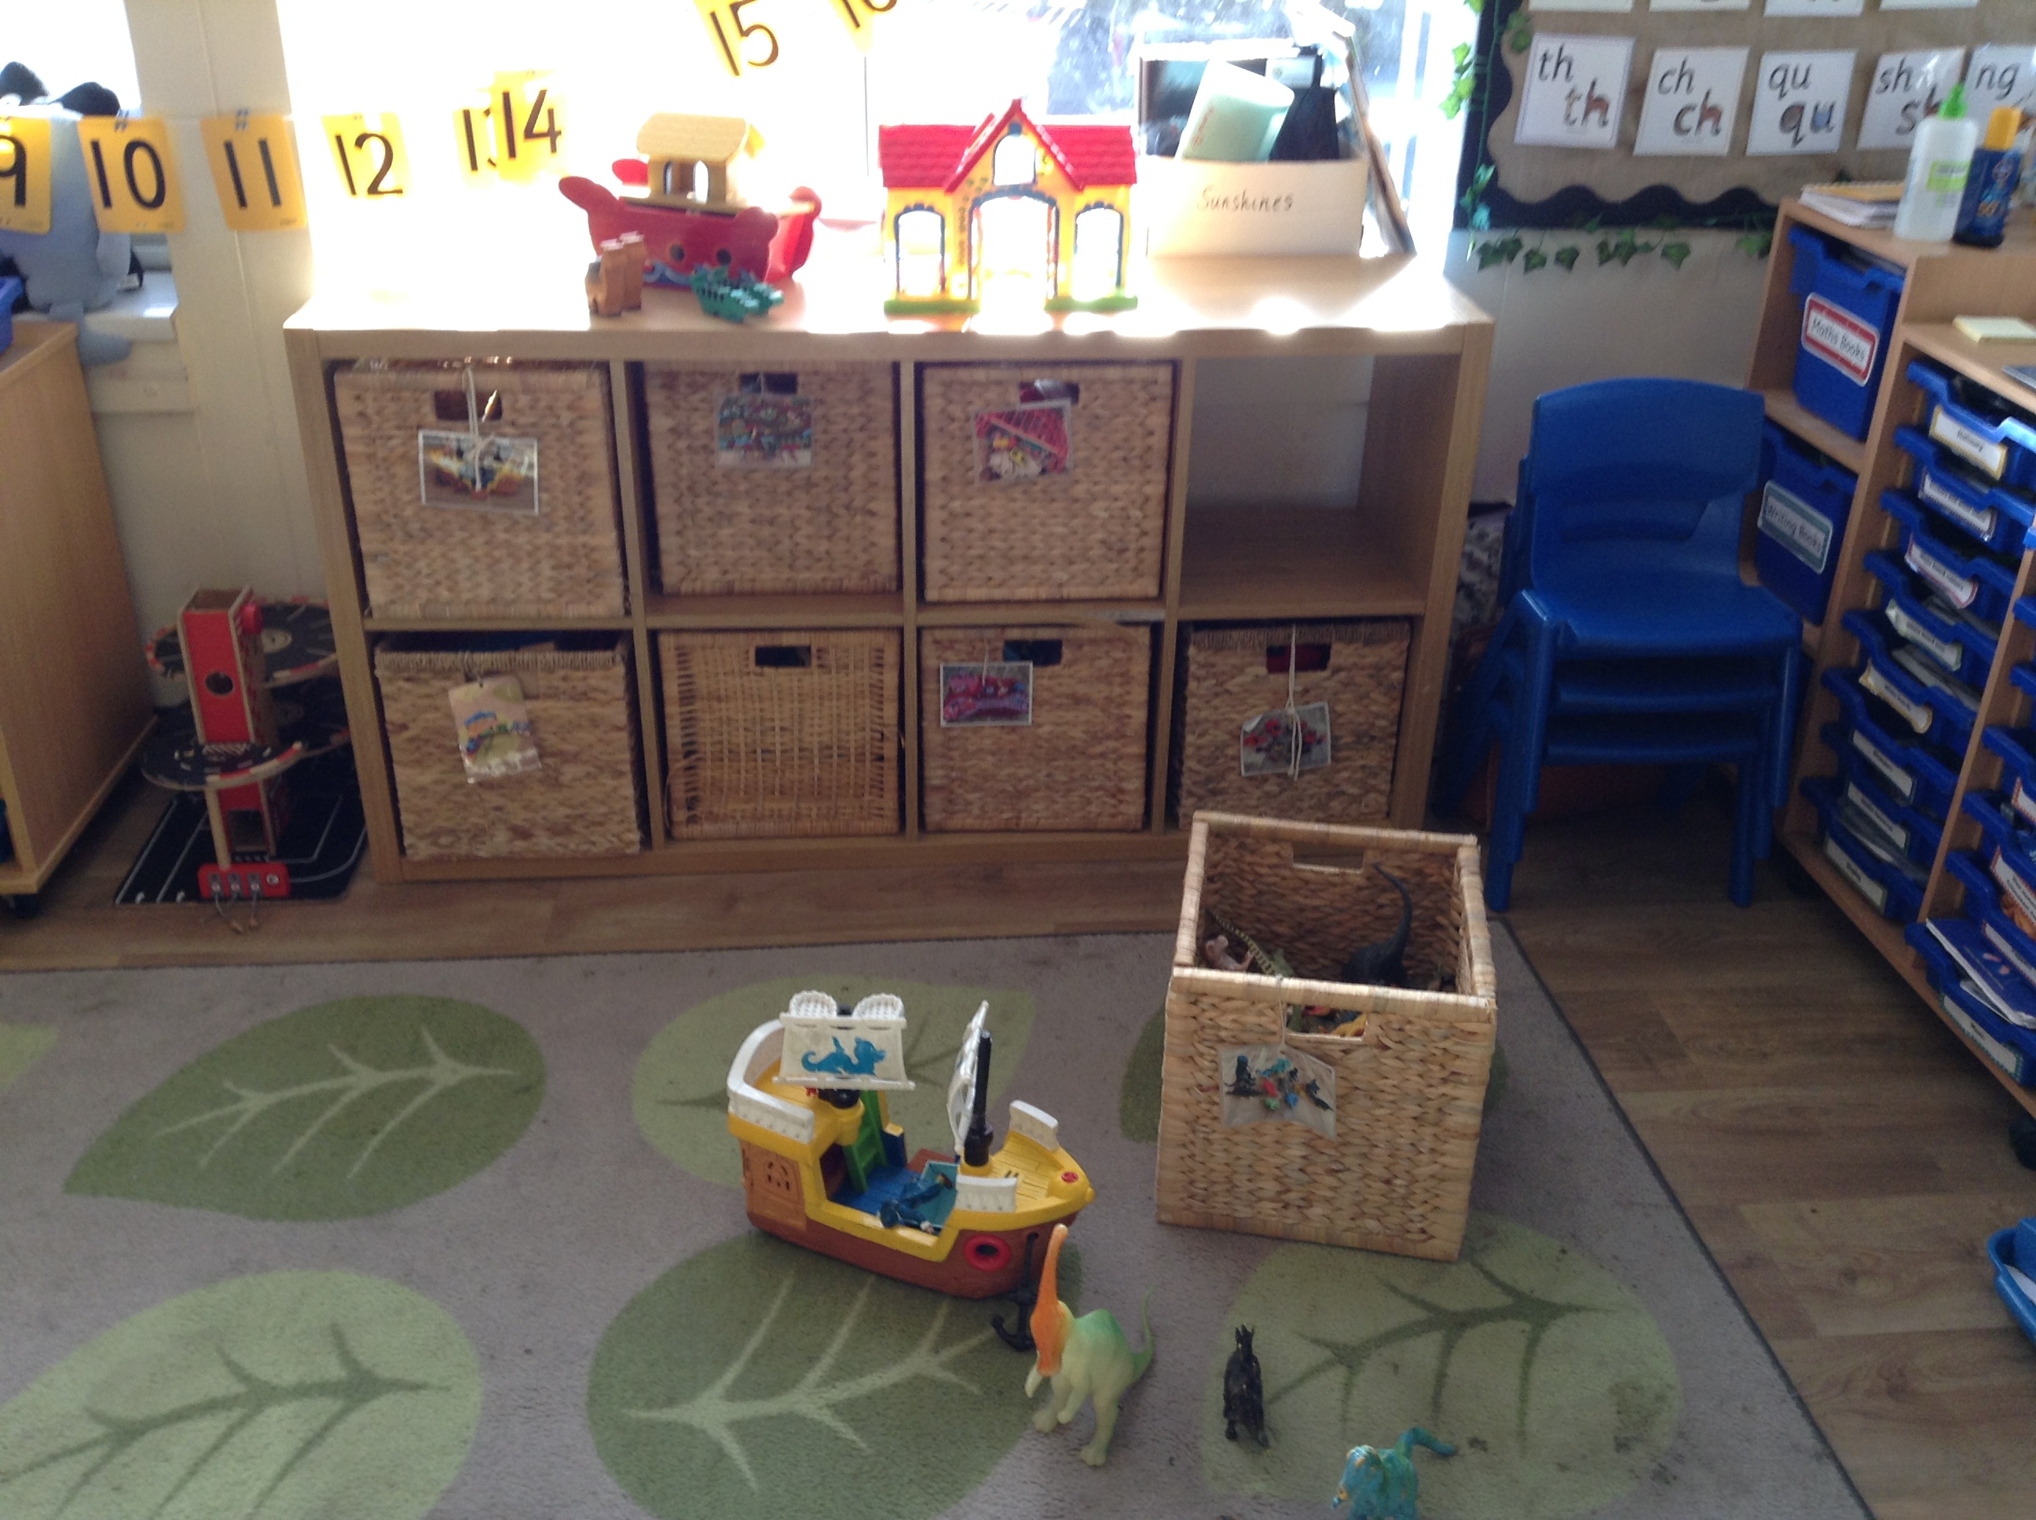
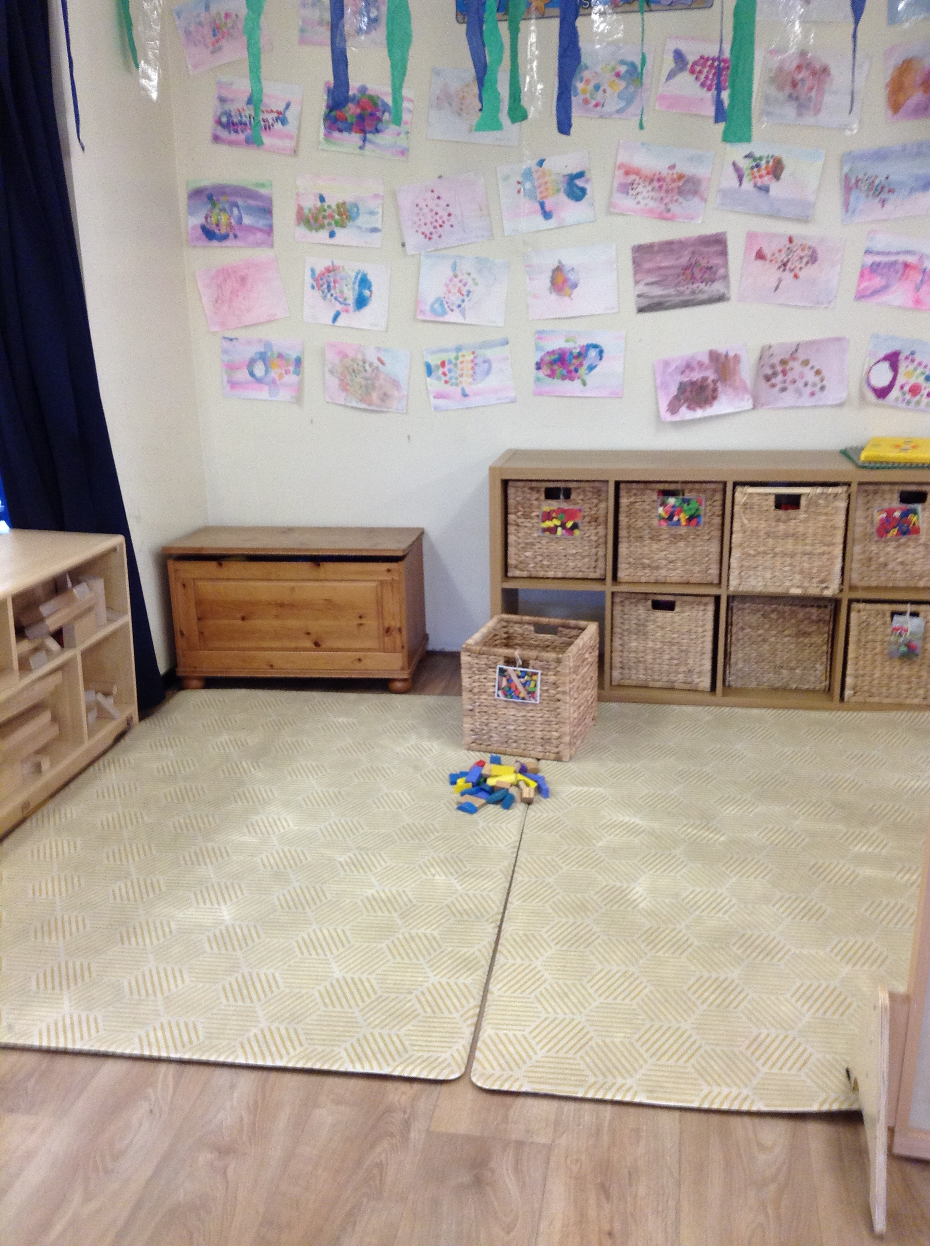
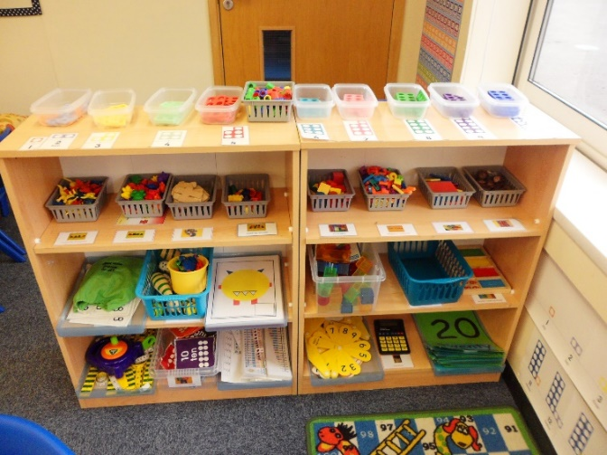
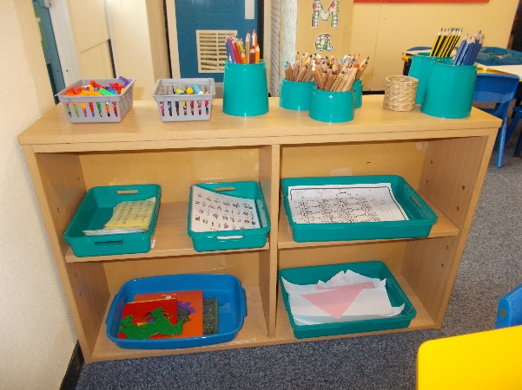
Enabling Environment
Small World Area
Construction Area
Maths Area
Writing Area
Notes:
Different areas for the chn to access during Continuous Provision.
CP - Time where chn can choose the resources they would like to play and learn with.
Its really important for chn to practise and consolidate things they have been taught during target group time.

Slide 6
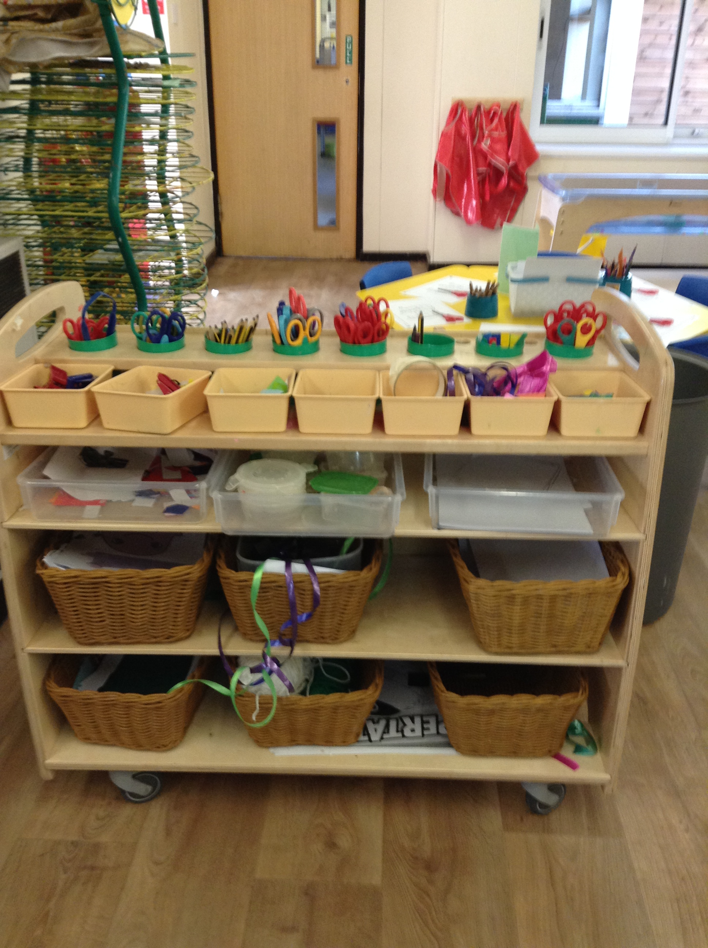
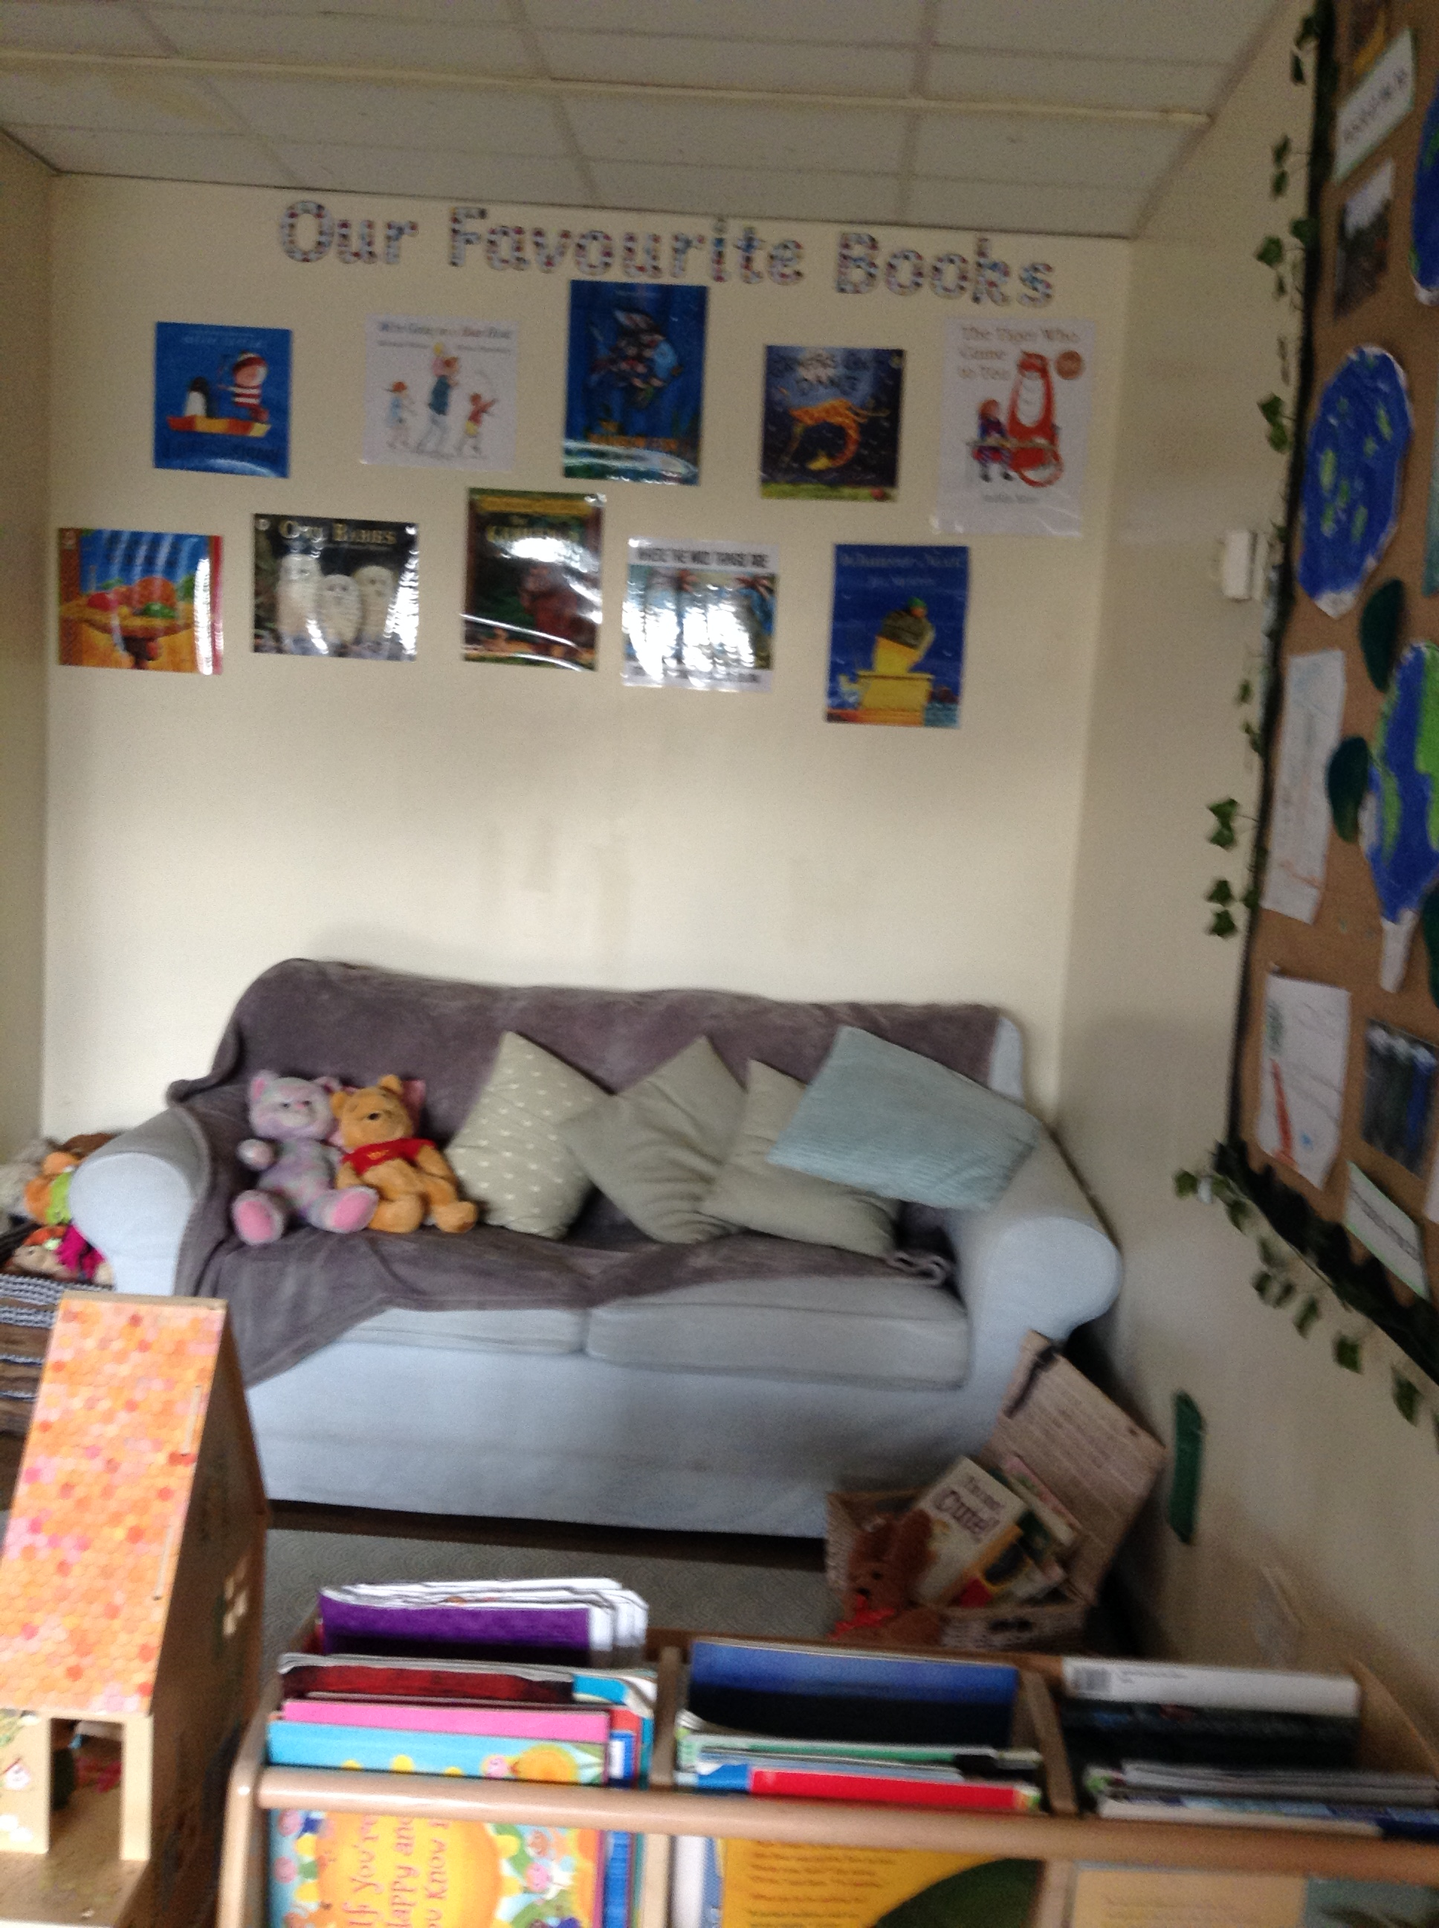
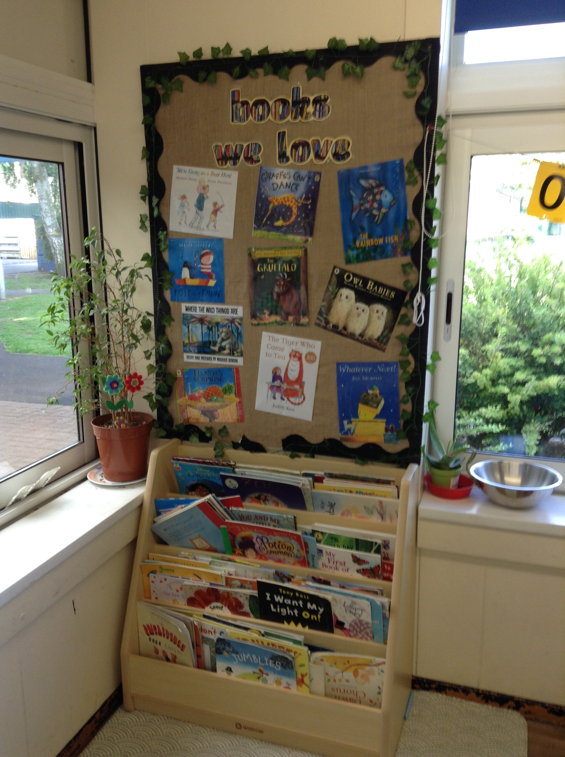
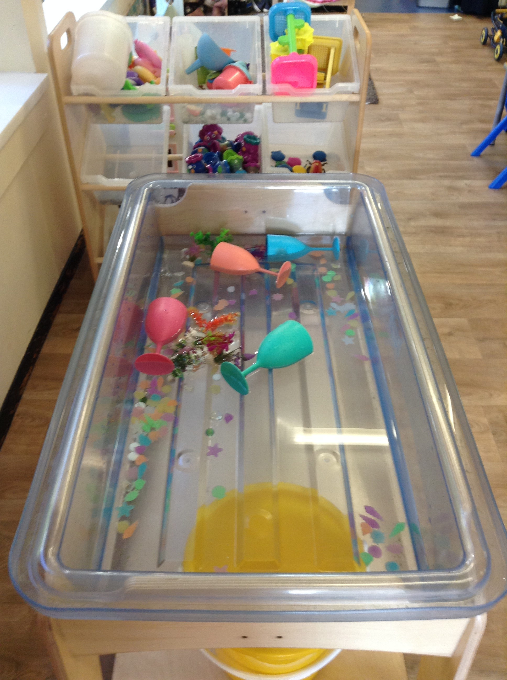
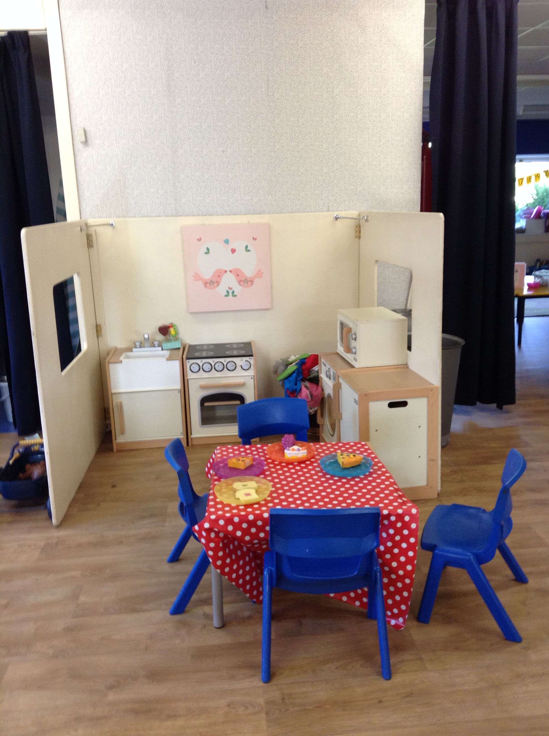
Making Area
Reading Area
Water Shelf
Home Corner
Notes:
Home corner – also different role play area which changes with topic.
Some aspects change whereas other things remain the same so that chn can plan things they would like to do and become secure in different areas.

Slide 7
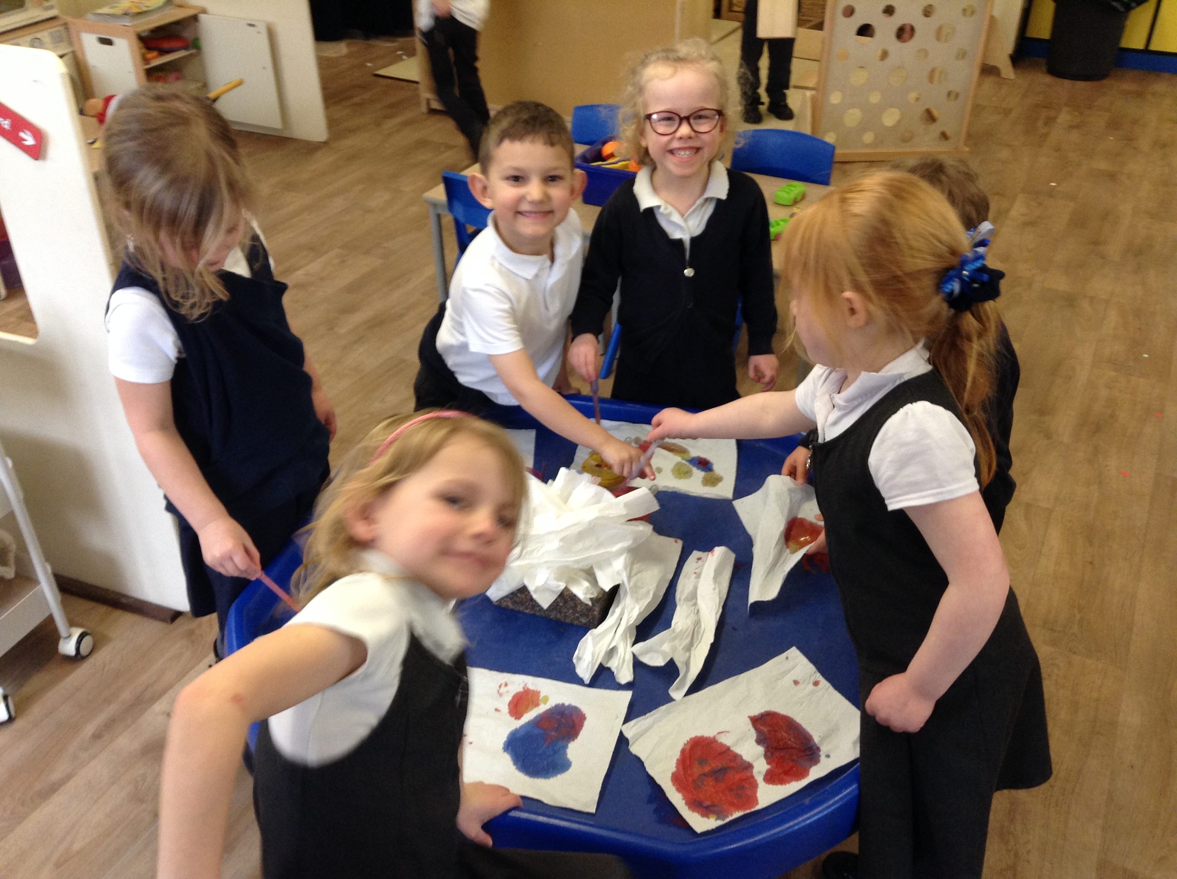
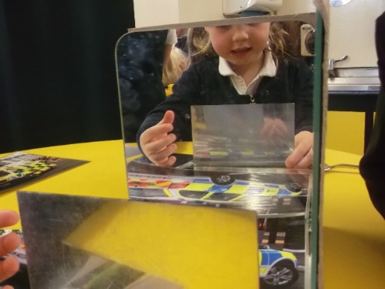
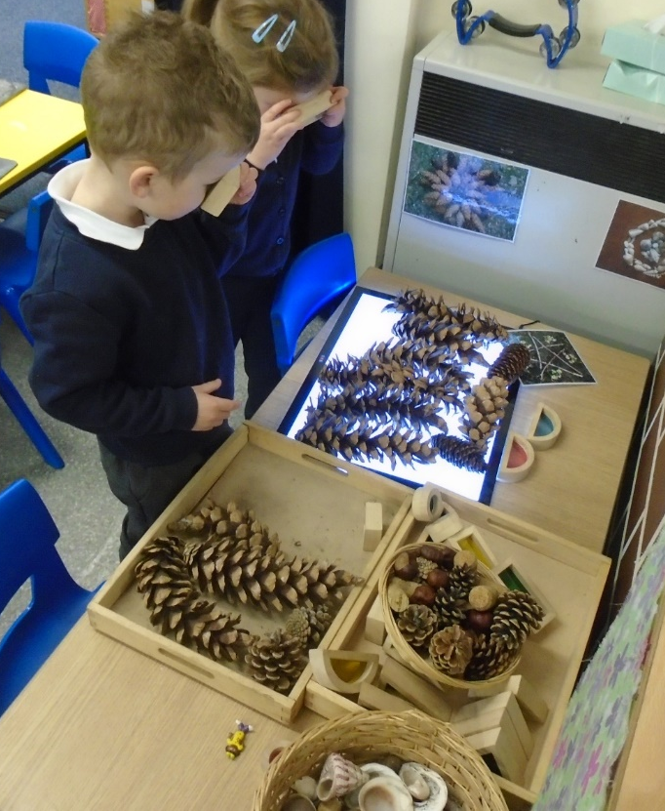
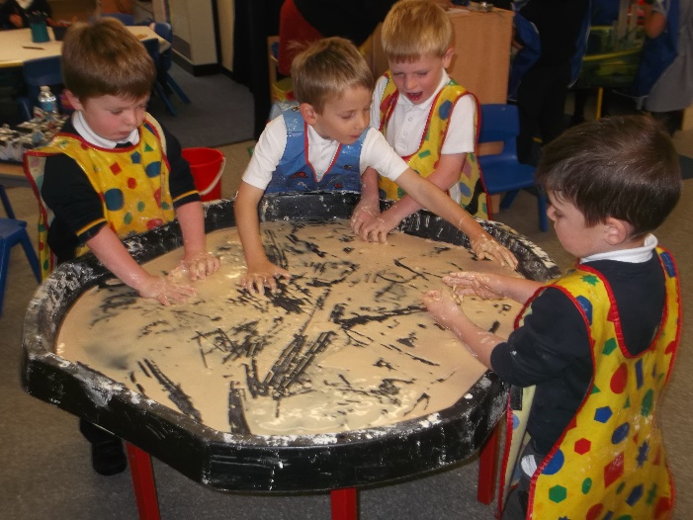
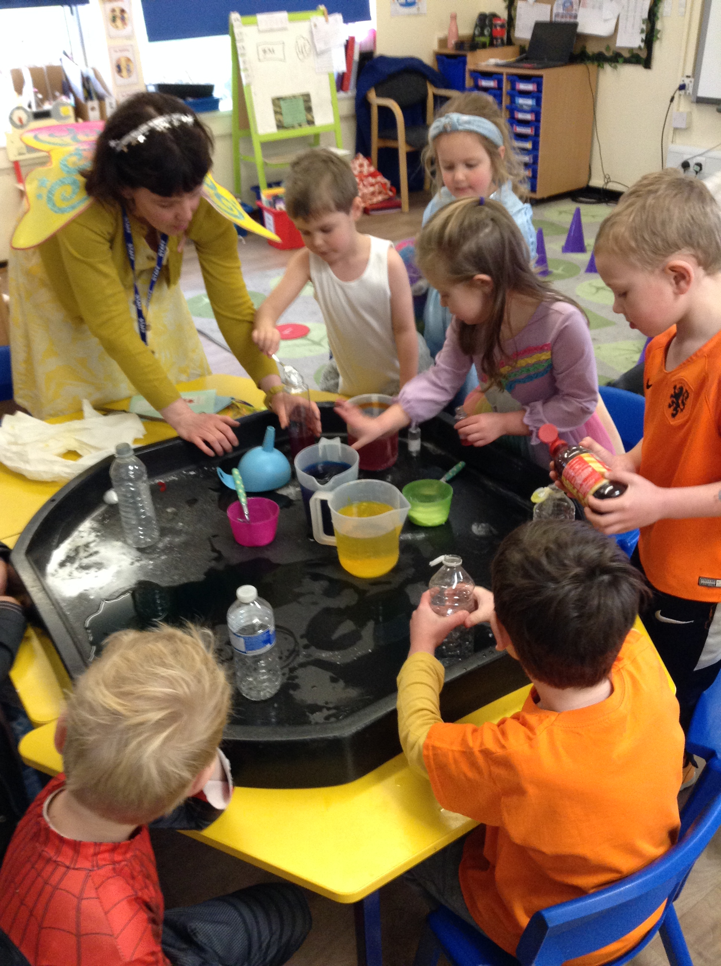
Investigating
Notes:
We do lots of investigations.
They develop the CoEL – encourage exploration, finding things out for themselves, not giving up, trying different methods. Etc.
Top right – using vinegar, bicarbonate of soda and food colouring to experiment and make different reactions – totally child led – no time limit.

Slide 8
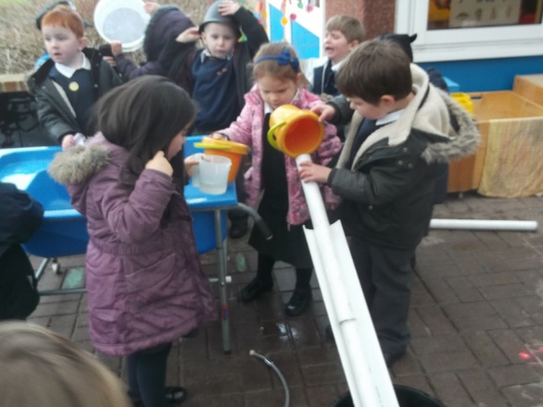
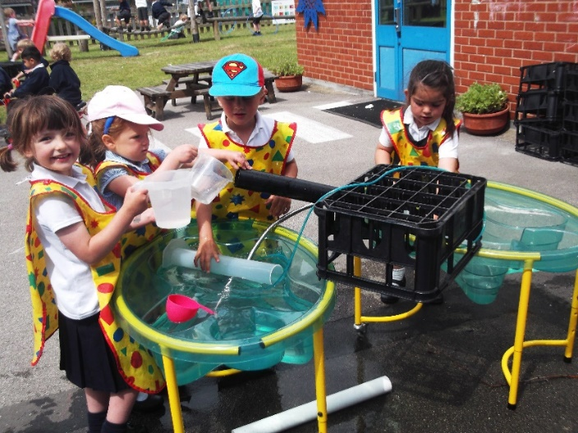
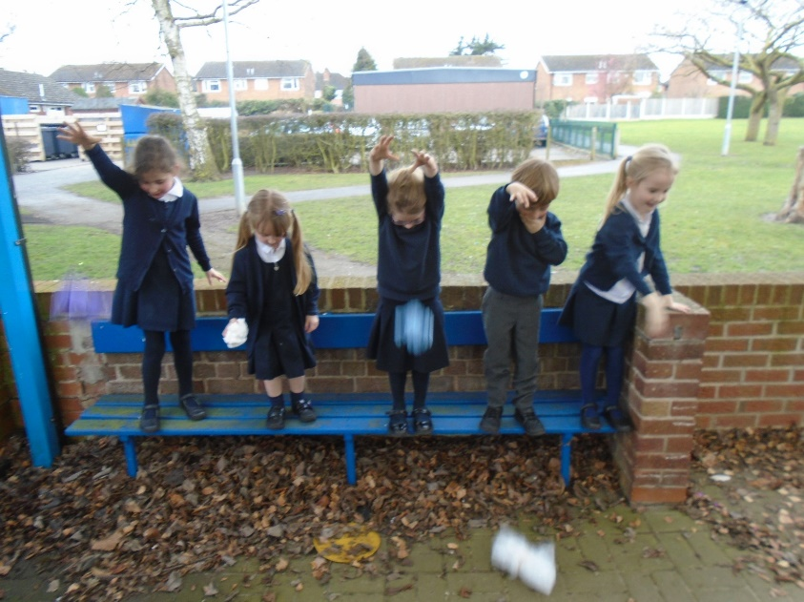
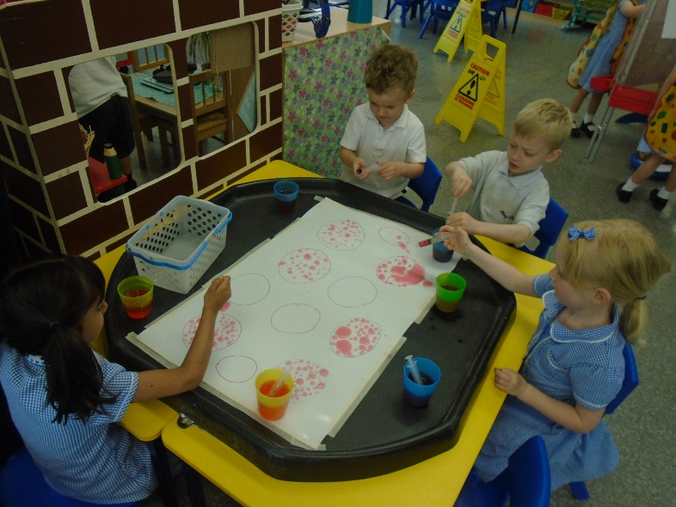
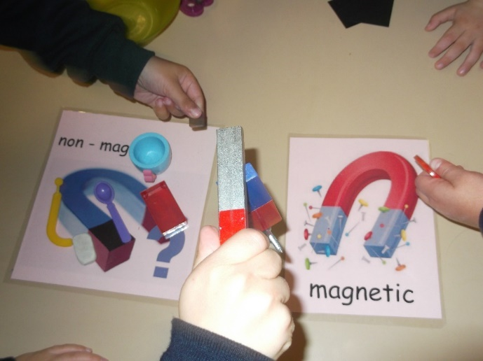
Notes:
Experimenting by moving the water from one container to another using pipes. Develop team work.
Eggs – which material is best to protect the egg?

Slide 9
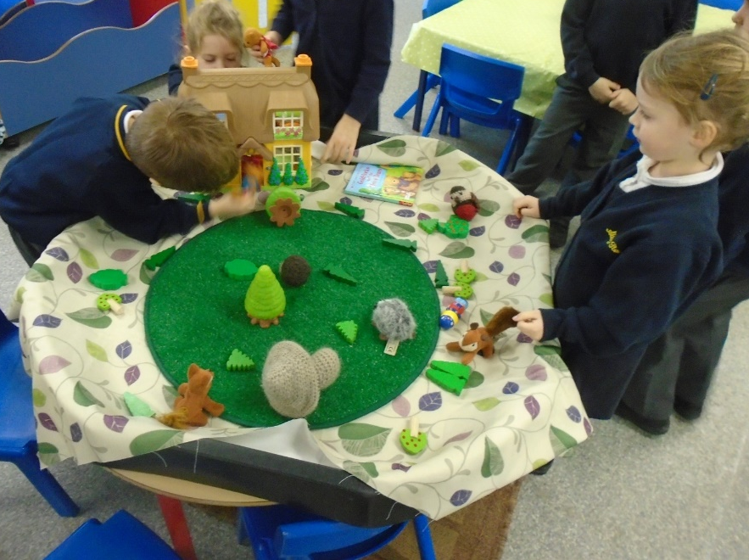
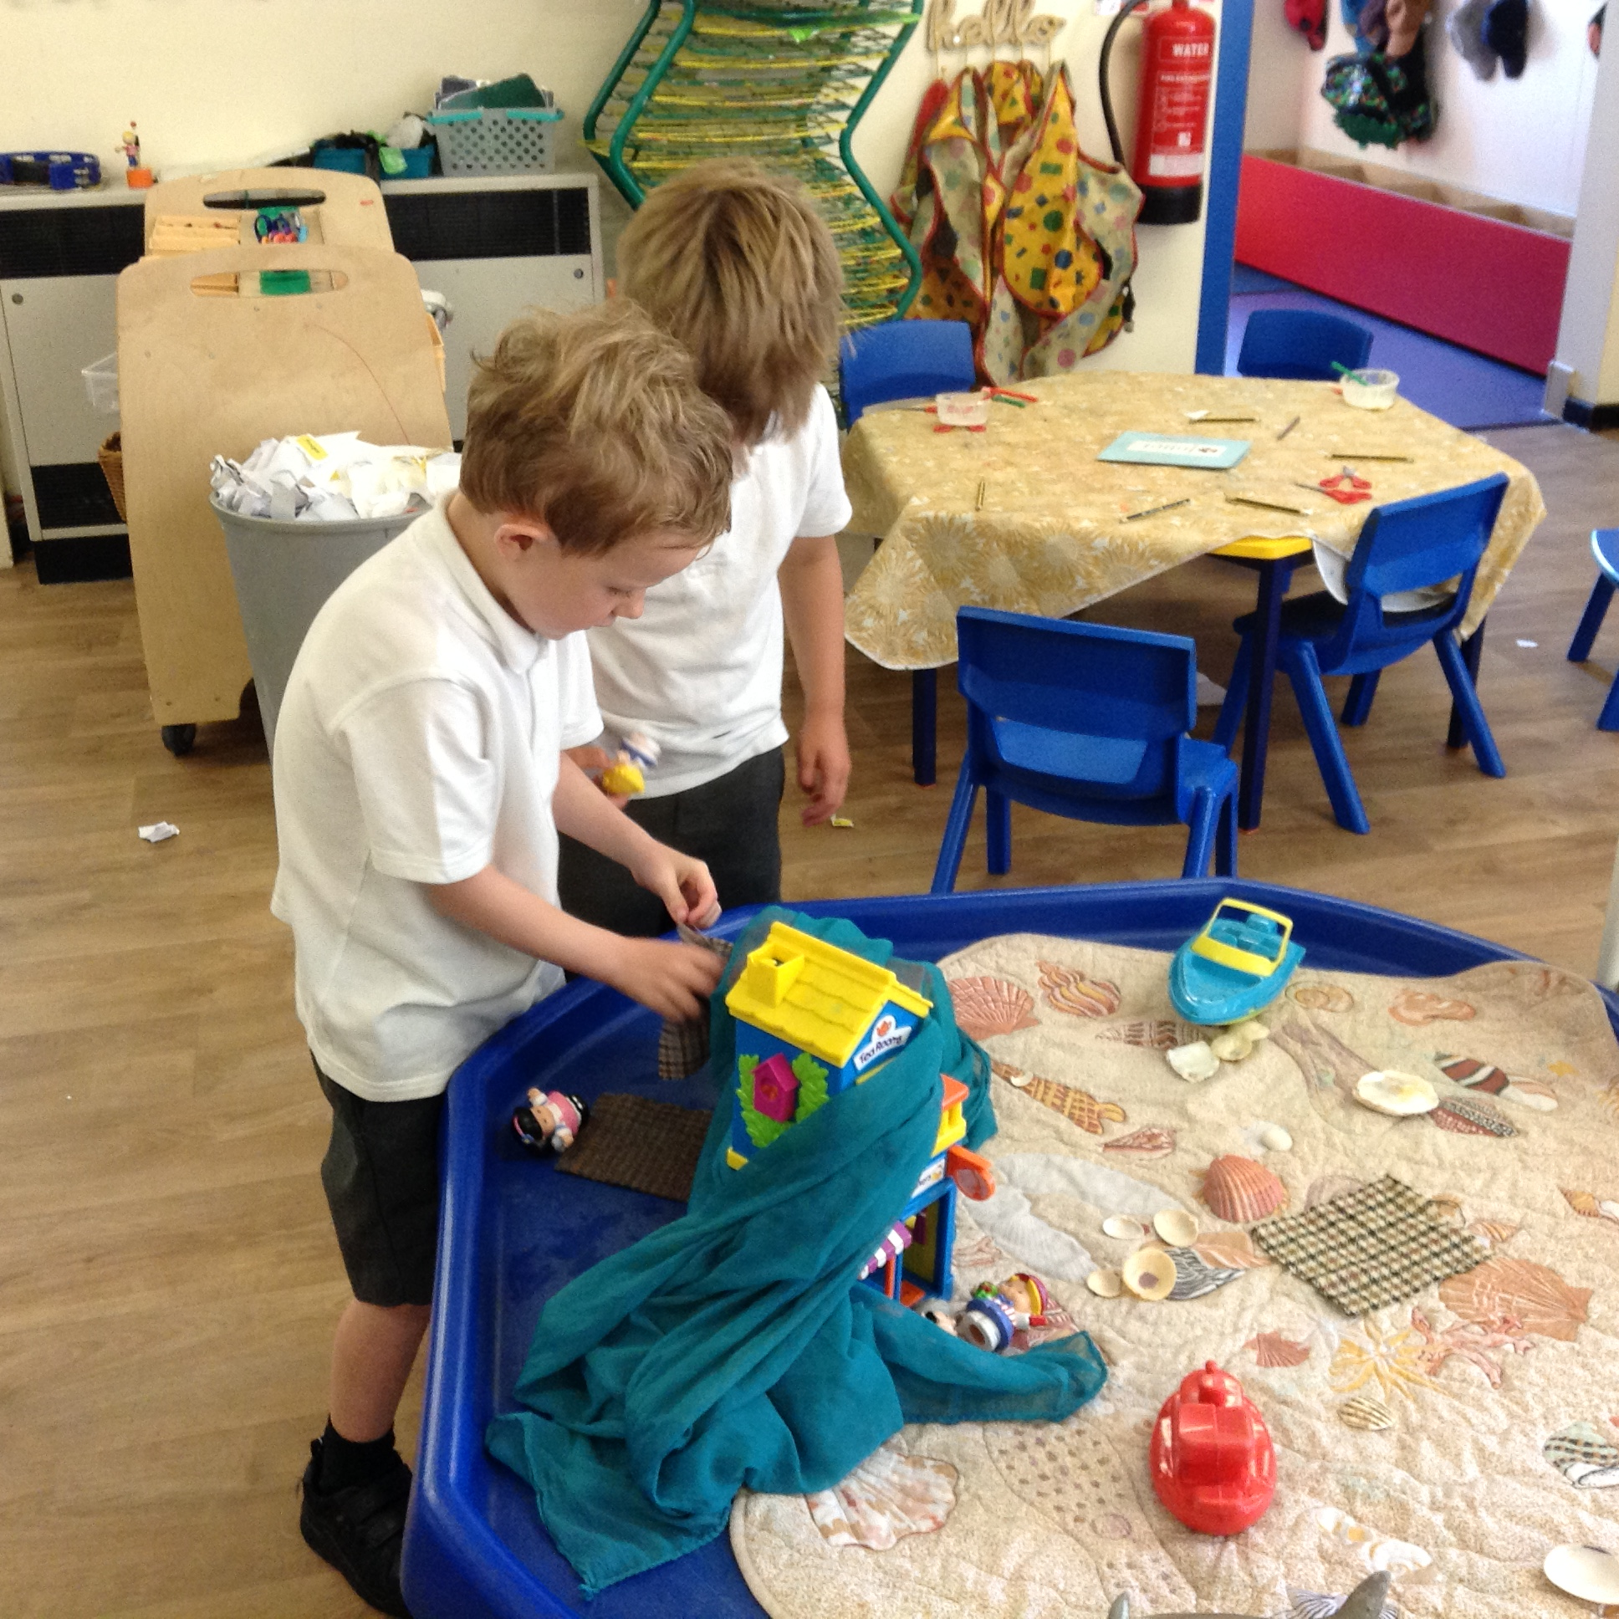
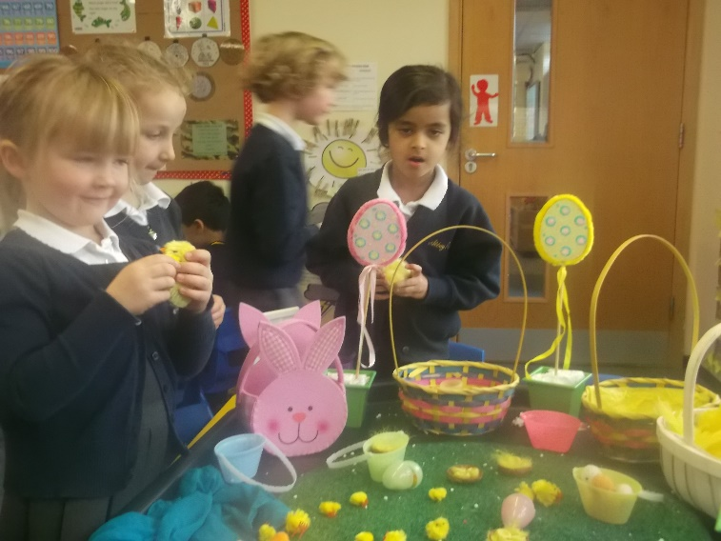
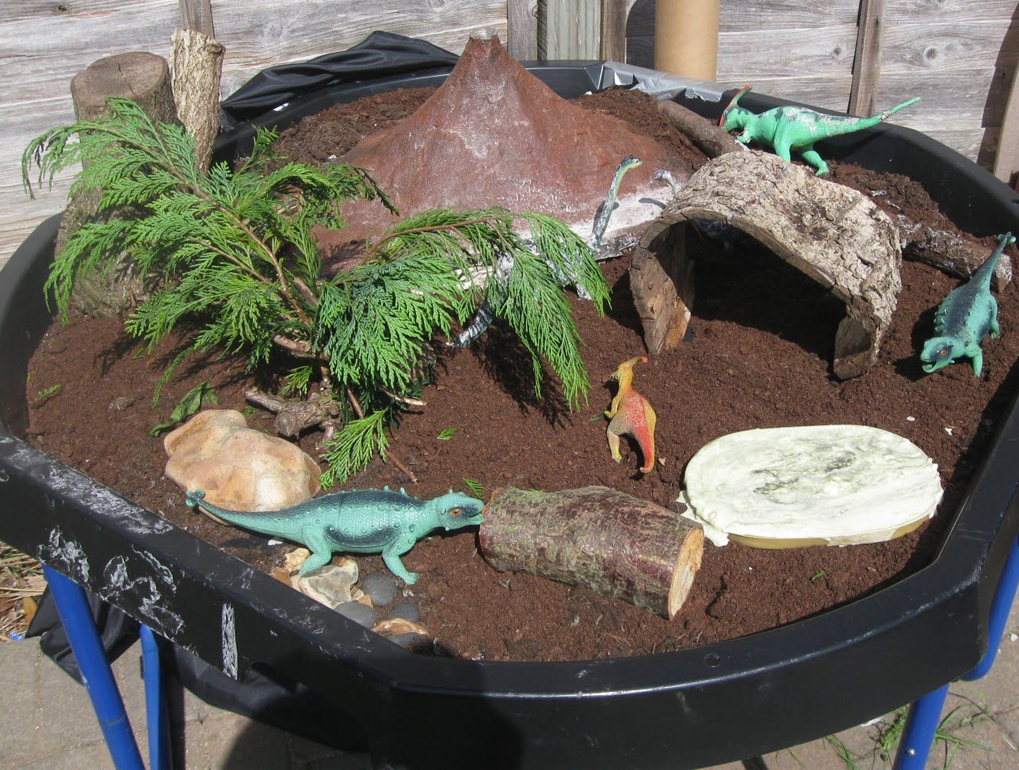
Small World Area
Notes:
Thinking about PSE and communication and development…the small world area really helps to develop these skills.
Work together to negotiate roles and take turns talking.
It allows them to develop speaking and language.
Top two – Goldilocks and three bears and three little pigs – allows chn to practise retelling the story and use language / vocab after they have heard the story read to them.

Slide 10
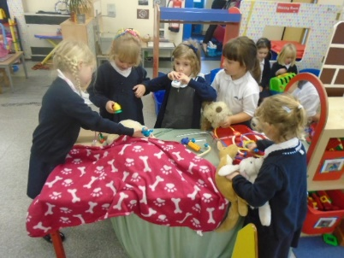
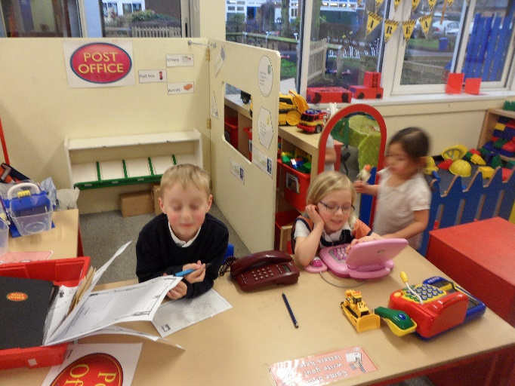
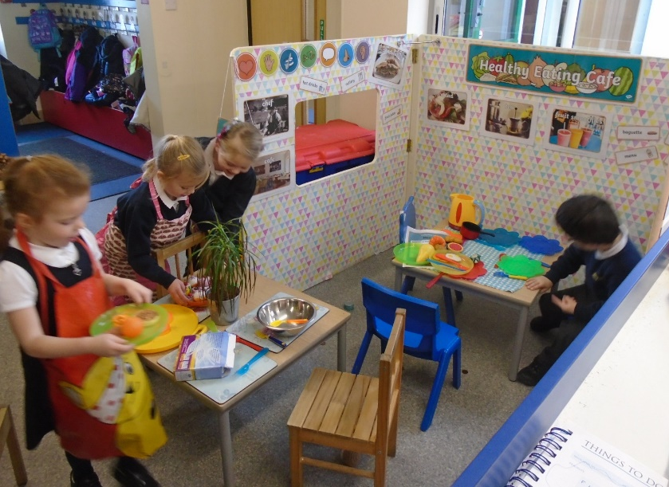
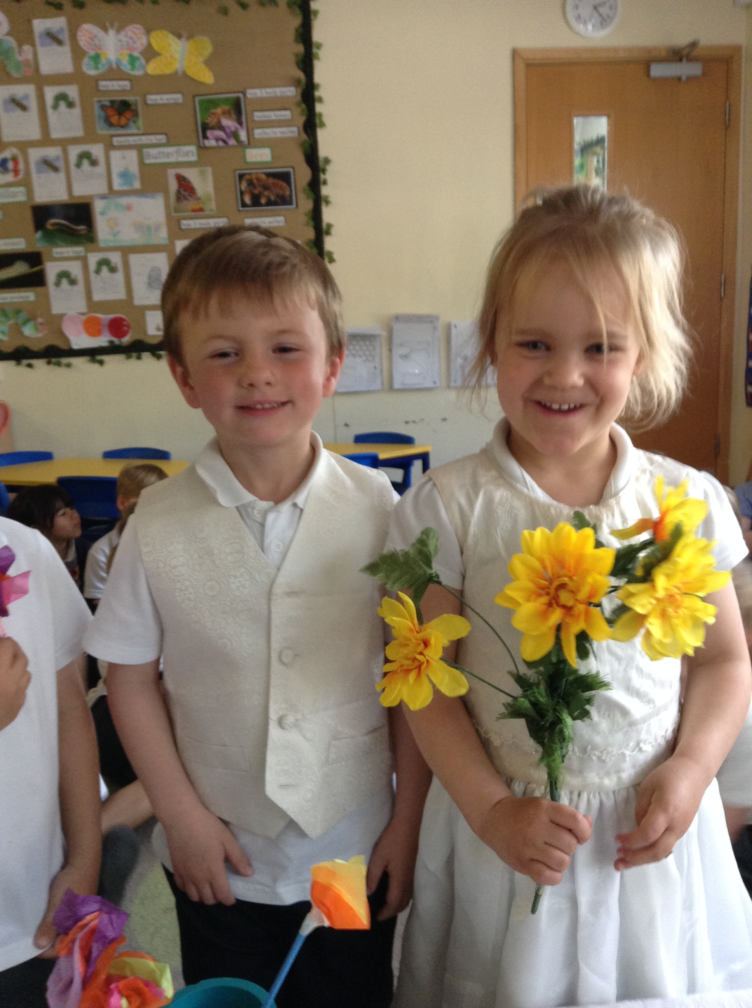
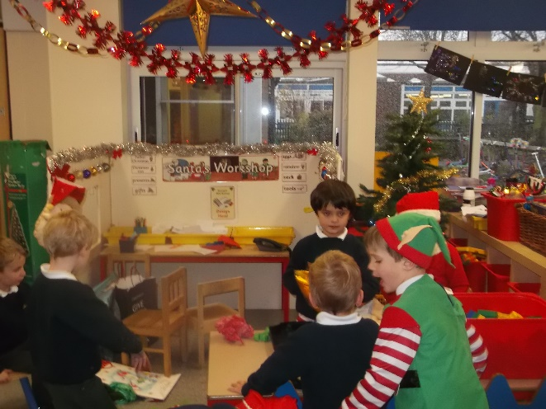
Role Play
Notes:
Role Play also develops PSE and C+L…chn learn to work together.
Changes with topics and themes although the Home Corner remains the same.

Slide 11
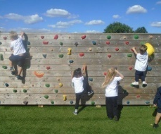
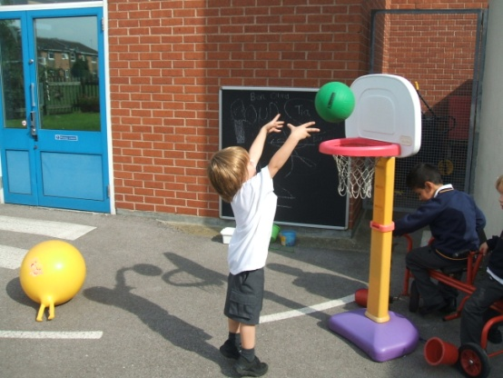
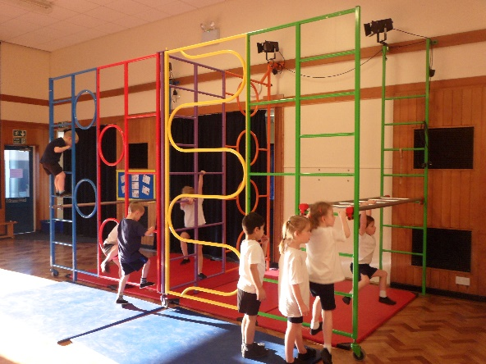
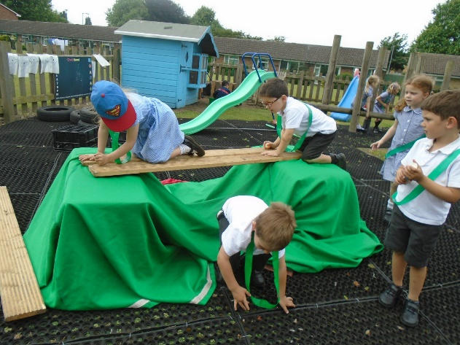
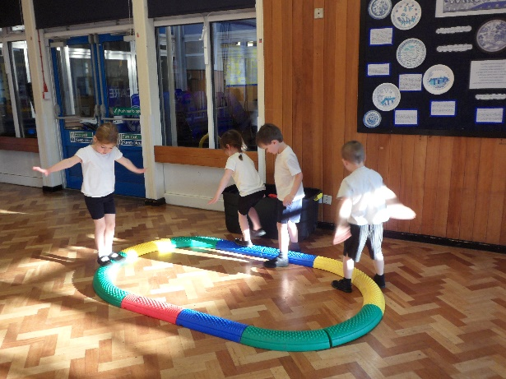
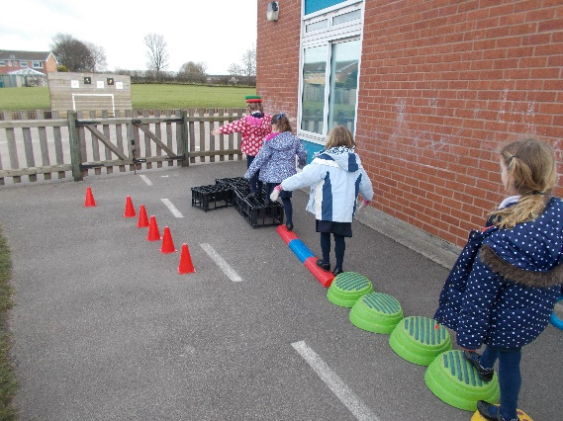
Physical Development
Notes:
Lots of opportunities to develop PD.
Some adult-led and some during CP – again chn can practise and consolidate skills that have been taught.
Gross motor skills
Negotiating space, balancing timber trail,
Jumping, hopping, skipping, hopping from one foot to another
Throwing and catching

Slide 12
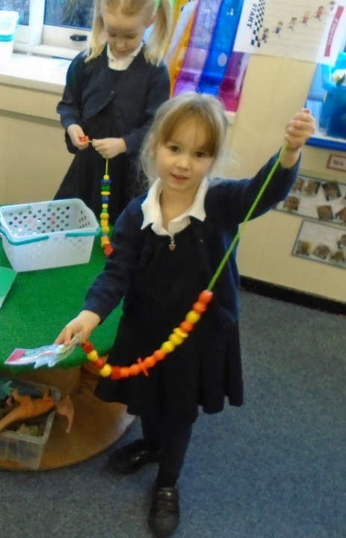
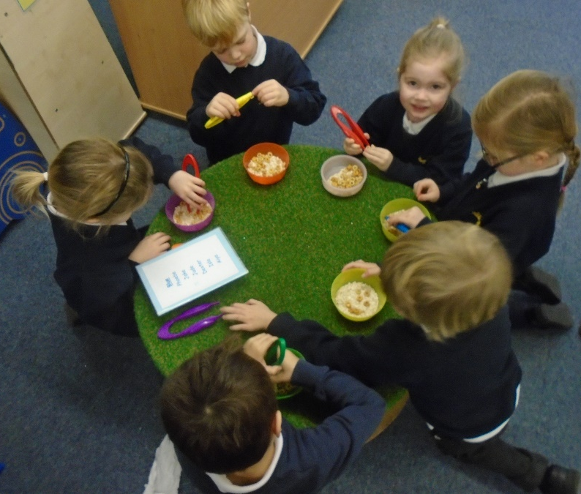
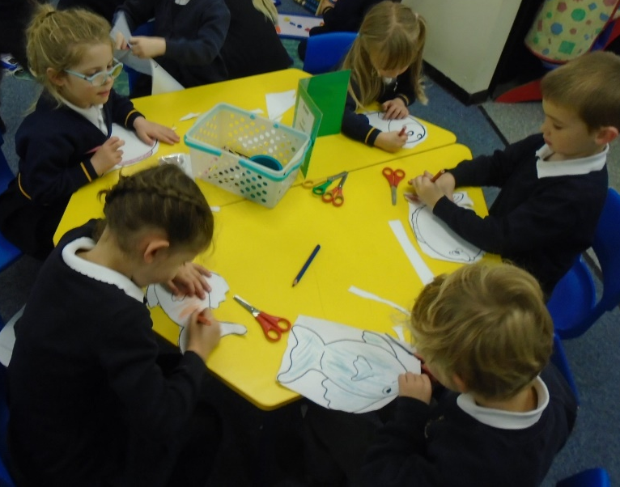
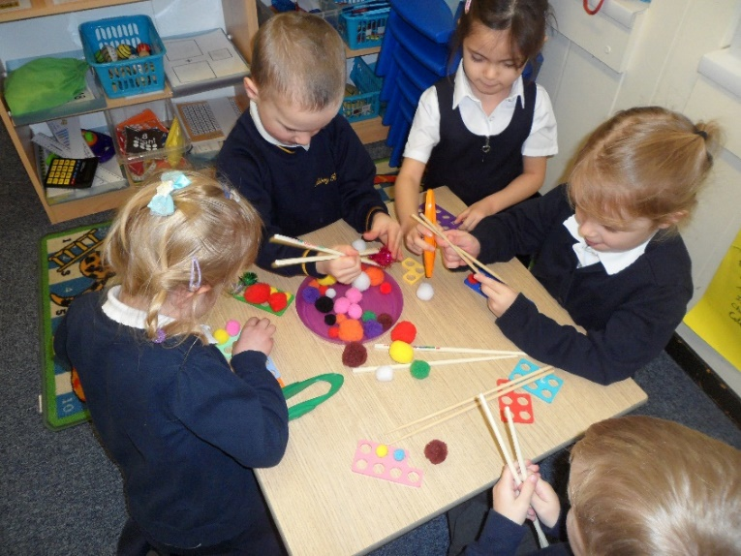
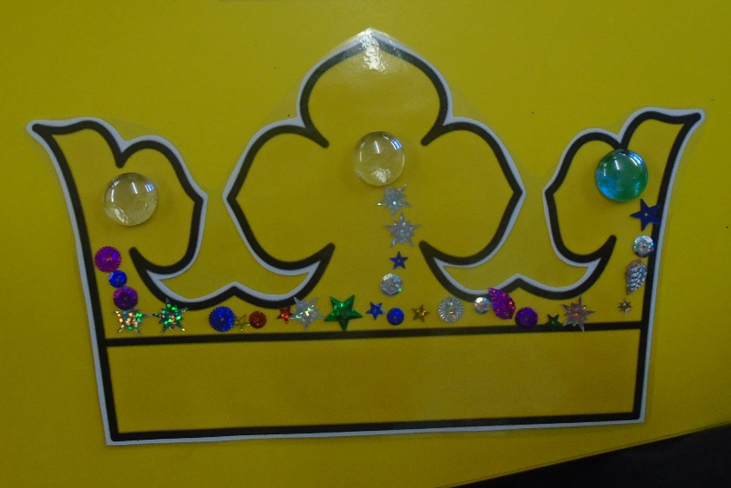
Finger Gym
Notes:
Finger gym is about developing fine motor skills – in hands. Helps with pencil grip and letter formation.
Control over the fingers is the last thing for chn to develop so they need lots of practise.
Tweezers and picking up small objects like sequins – similar shape to pencil grip.
Threading and using scissors.
Move on to practising letter formation, sentences.

Slide 13
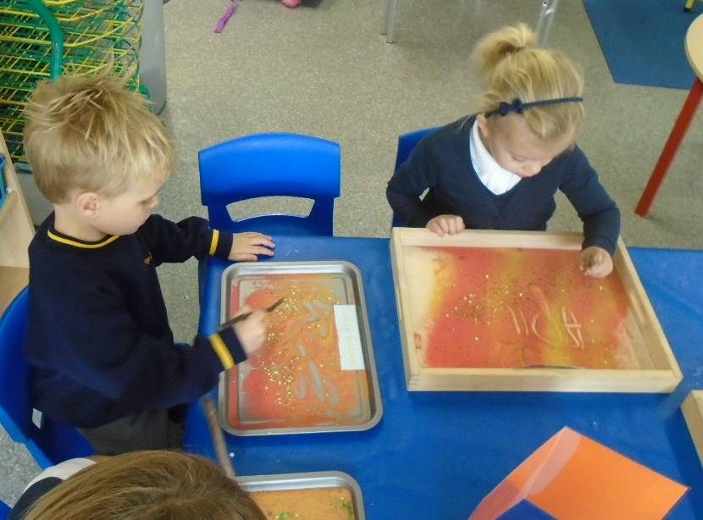
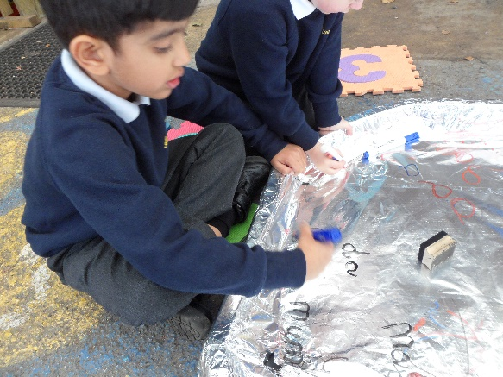
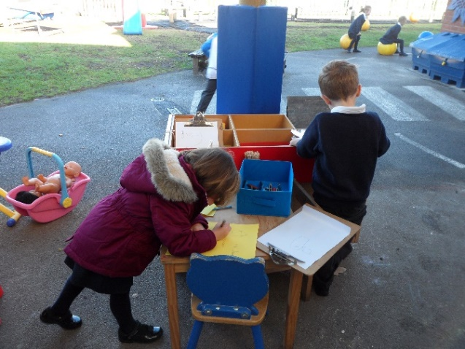
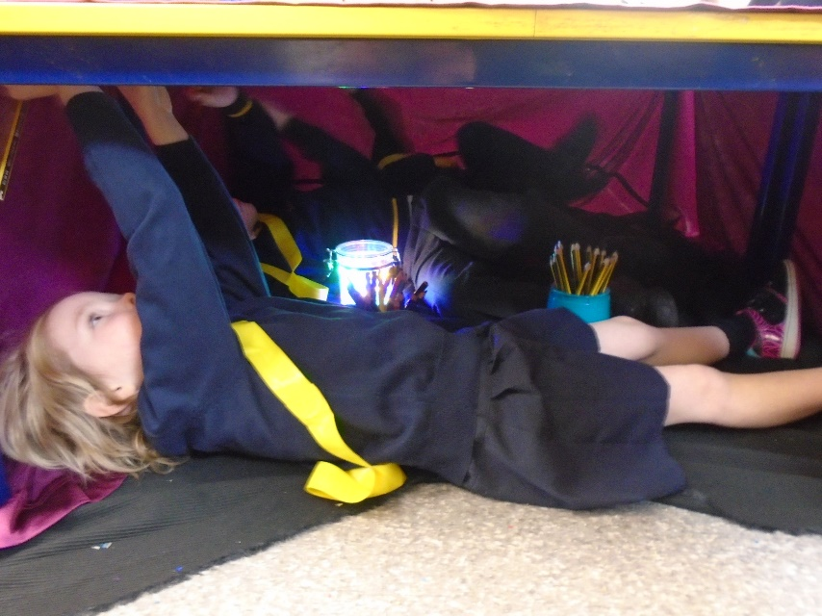


Writing
Notes:
Lots of opportunities for chn to practise their writing.
Writing area – range of papers, cards, booklets.
Different, fun ways…
Writing in sand with a twig, writing on tin foil with felt tips, writing under the table in a den.
Challenges to encourage all chn to use the area.

Slide 14





Writing for a purpose
Notes:
These are some ways we inspire and excite the chn about writing…
Medical report to make the Hungry Caterpillar better.
Dot and Dan sentences. They go on many adventures.
Based on the book Supertato. In that book there are some evil peas who aren’t very nice to the vegetables…we had to look after the vegetables and keep the evil peas locked away…but of course they escaped and we wrote our own stories.
Our dog Sam comes to stay. He runs away and we design lost posters.

Slide 15






Mathematics
Notes:
Maths area
Chance to reinforce skills they have been taught in their own time.
Come up with their own games.
Practise number, recognition, counting and as time goes own addition, take away, doubling and halving.
Challenges each week – read the number on the pumpkin and count out conkers and pine cones.
Another challenge – numbers on ghosts – call the number out and squirt with the water.

Slide 16






Shape, Space and Measure
Notes:
Many opportunities to explore Shape Space and Measure for themselves. When we are teaching an aspect, such as measure, we will ensure there are plenty of things chn can do to practise this skills. Eg measure the penguins using the socks.

Slide 17






Expressive Arts and Design
Notes:
The chn can use the Creative Table to make their own artwork or models.
They will practise skills like painting, mixing colours, using staplers, hole punches, treasury tags.

Slide 18




Notes:
Planned and designed a dragon – worked together.
You’ll enjoy having lots of lovely box models coming home! Keep for a short time and value / praise.

Slide 19





Understanding the World
Notes:
Understanding the World involves
Looking at local environment.
Animals and plants.
Taking care of the world
Different occupations, people who help us. Fire fighters, Police,Doctors, Nurses.

Slide 20






Notes:
Also technology falls under this area – using ipad, laptop, simple coding.
Real life experiences – eg going on an aeroplane – design passport, bring in a packed suitcase.

Slide 21




Forest Schools

Slide 22
    If you would like to see more…
    www.abbeyroadprimary.co.uk
    Children
    Reception

Slide 23

    “Adults who help children to play are adults who help children to learn.”
Notes:
As you can see your children will be very happy and busy.
We would just like to finish with this quote – adults who help children to play are adults who help chn to learn.
We feel this really captures our ethos here at Abbey Road.
Thank you!

