Slide 1
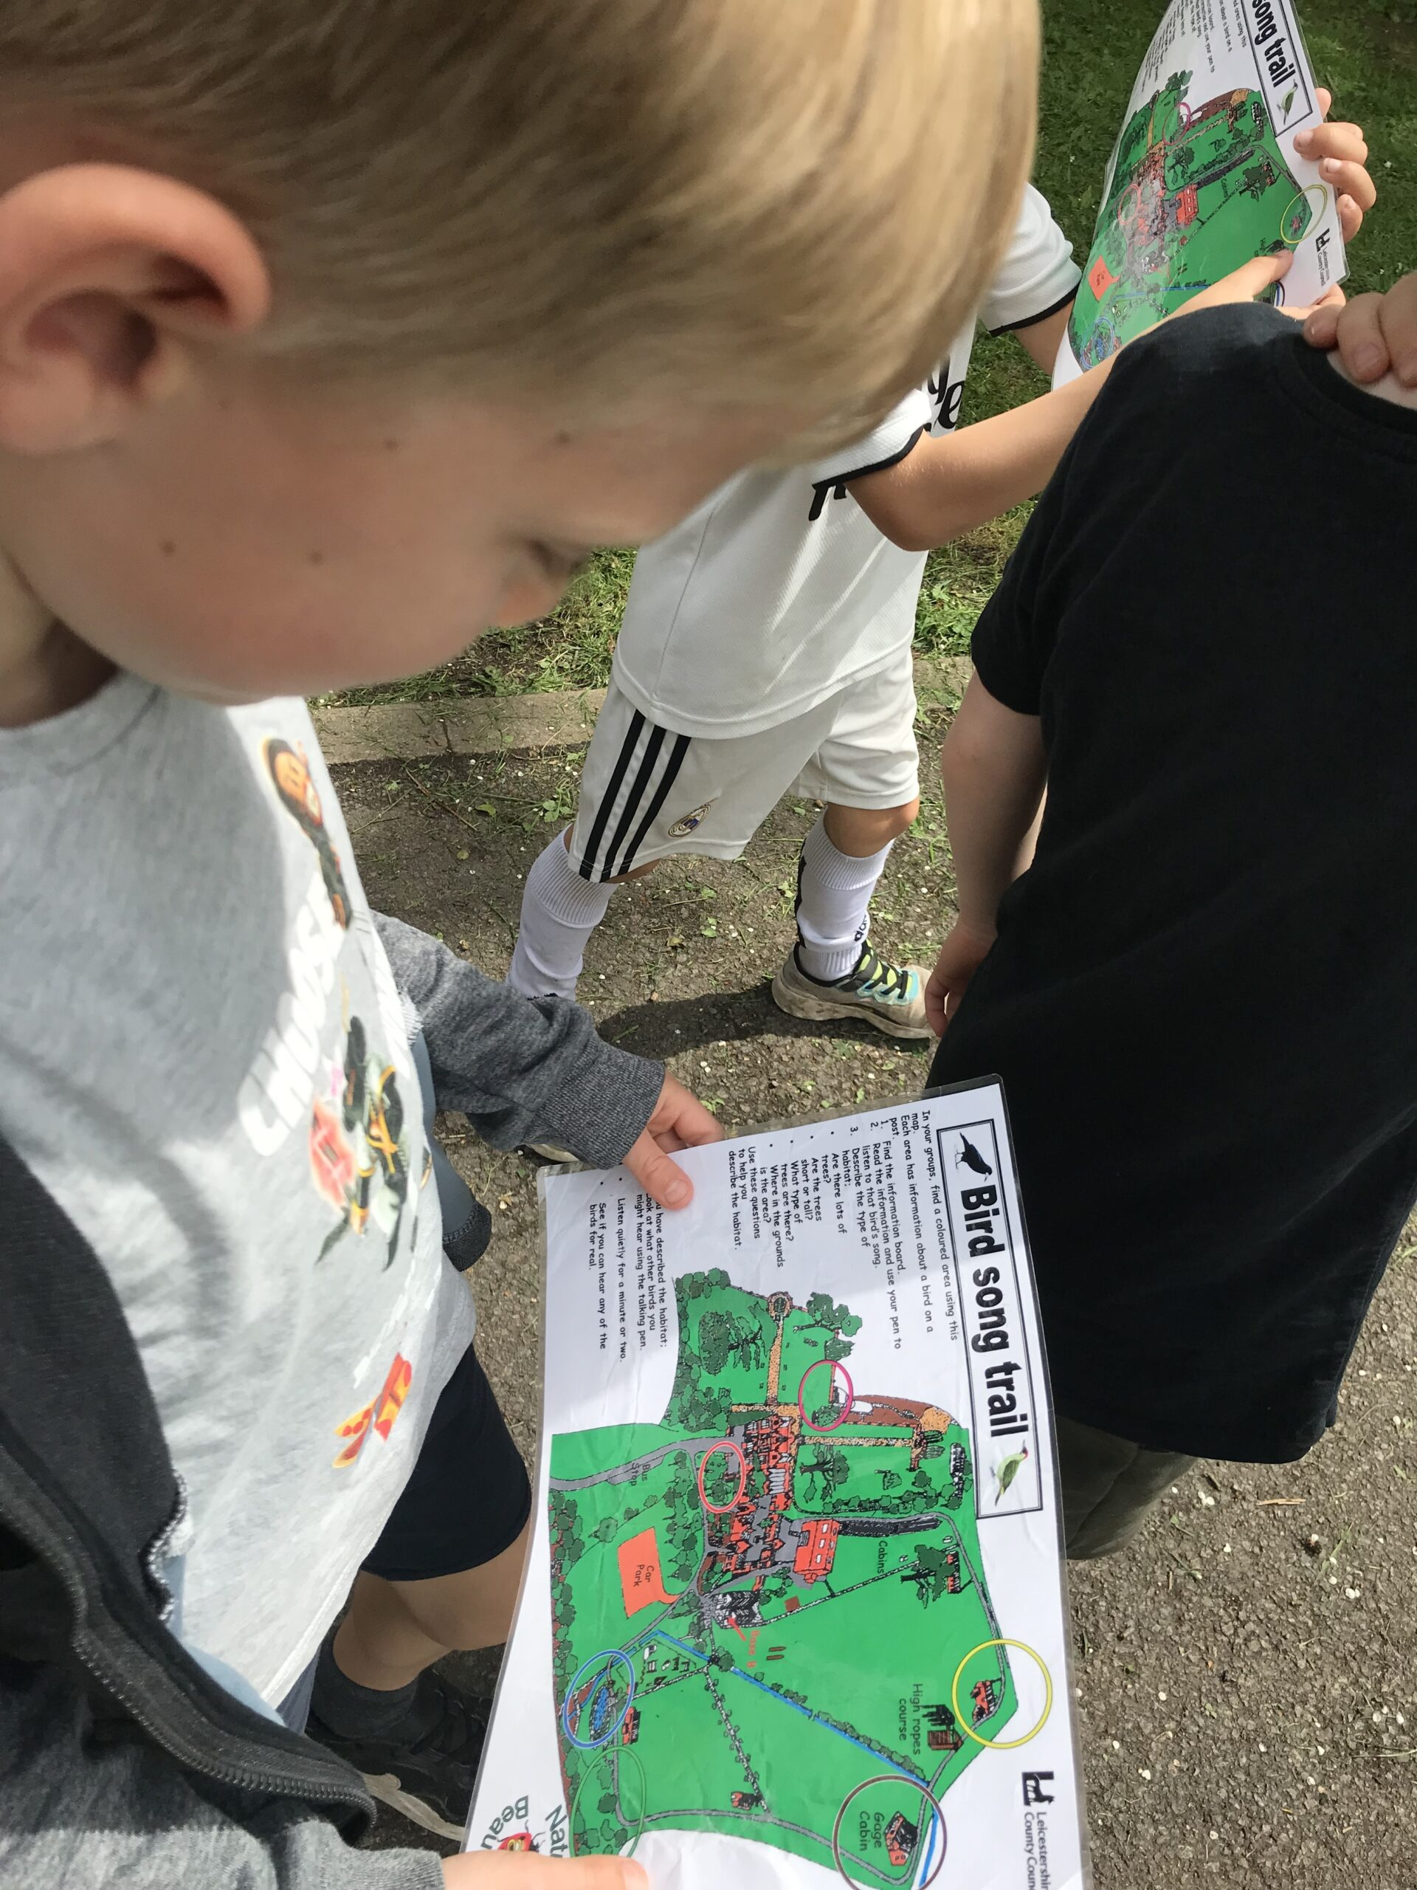

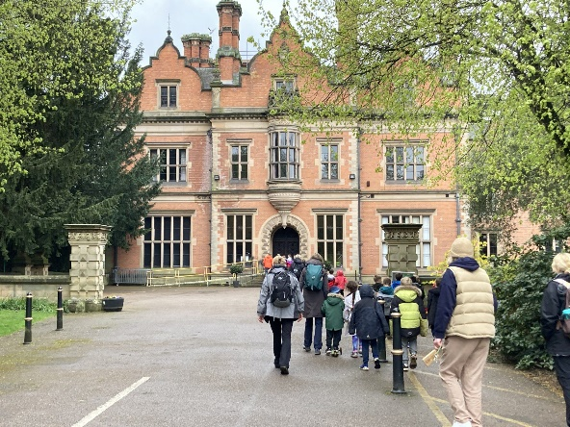
Year 2 Beaumanor Residential
Thank you for coming to our Beaumanor Information Evening. It’s lovely to see you all. ☺
Please make sure you have picked up the relevant forms/information sheets for your child and then find a seat.
Notes:
Charlotte

Slide 2
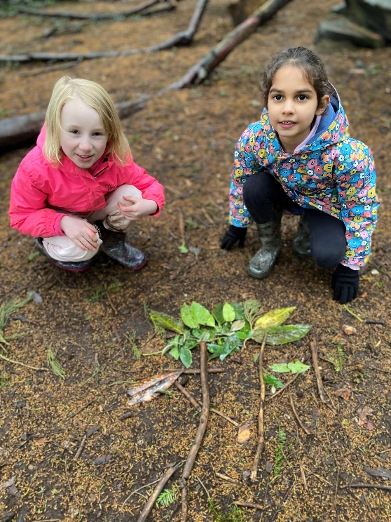
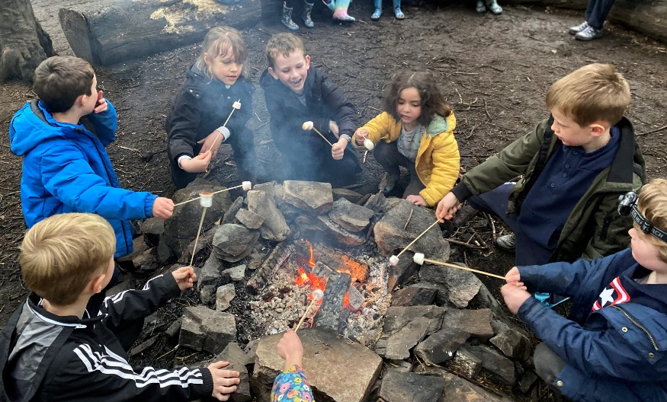
Residential Experience
SOME BENEFITS
Enrich the curriculum
Provide real life learning
Explore own potential
Increase self confidence
Team work and independence
Learn to manage risk
Notes:
Charlotte

Slide 3
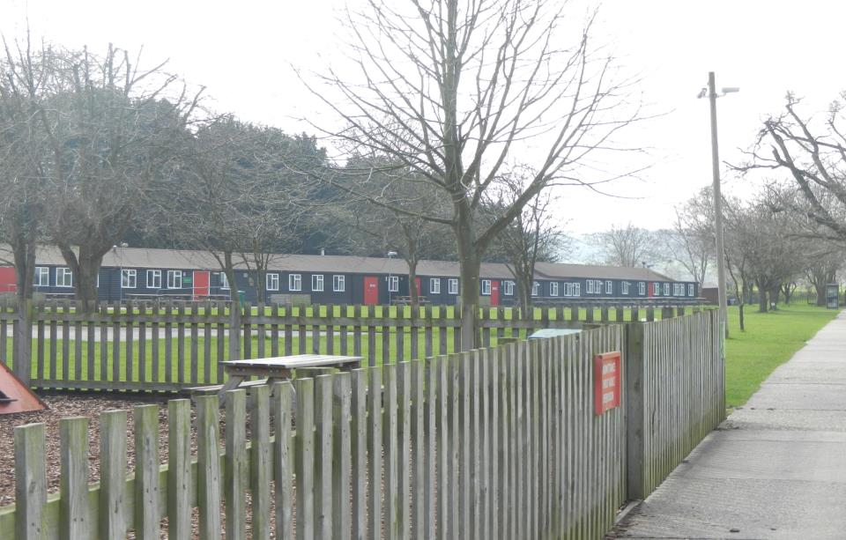
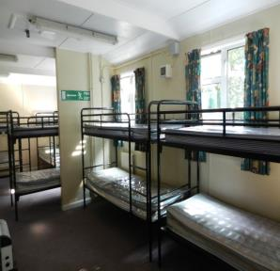
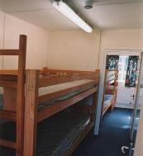
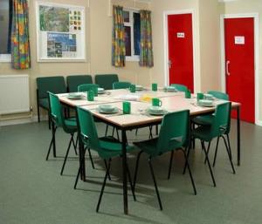
Arrival
2WP on Mon 28th April – Tues 29th April
2M Tues 29th April – Weds 30th April
Meet and greet off the coach
Escorted to a base room or cabins
Booking in procedures explained
Group settles in
Notes:
Charlotte

Slide 4
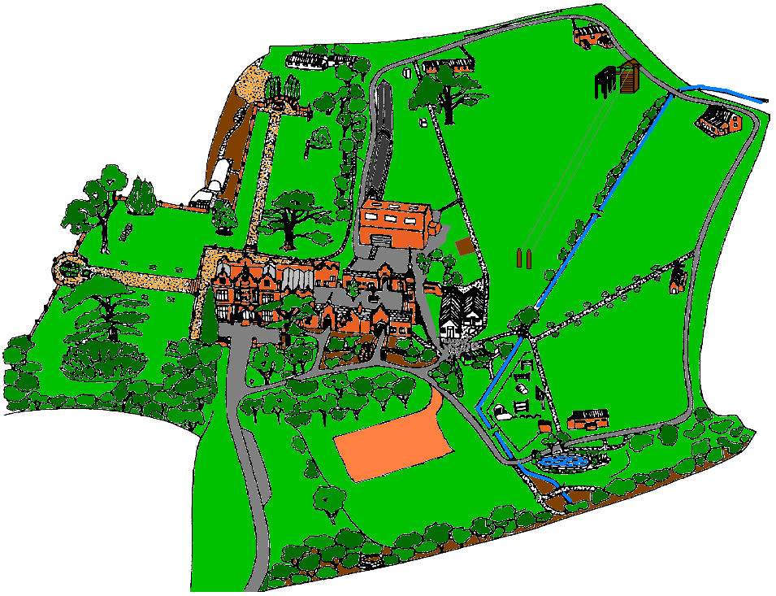
Notes:
Charlotte

Slide 5
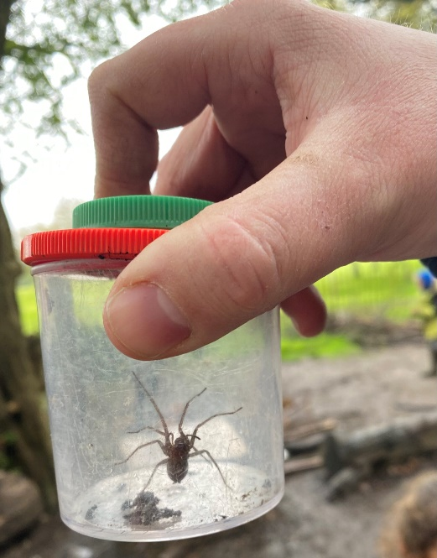
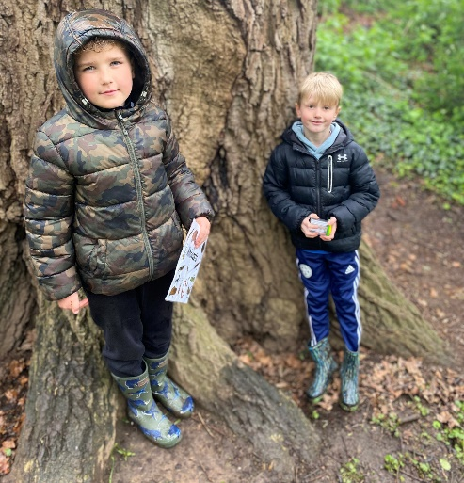
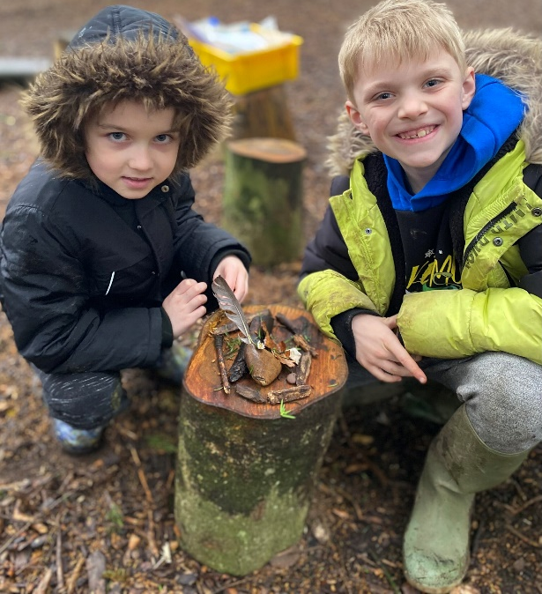
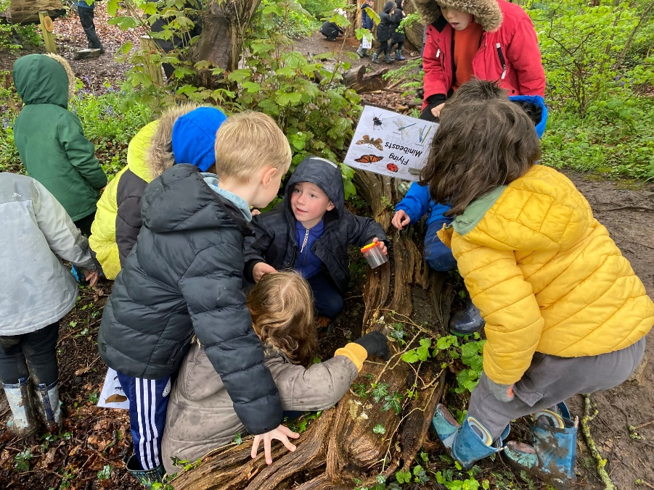
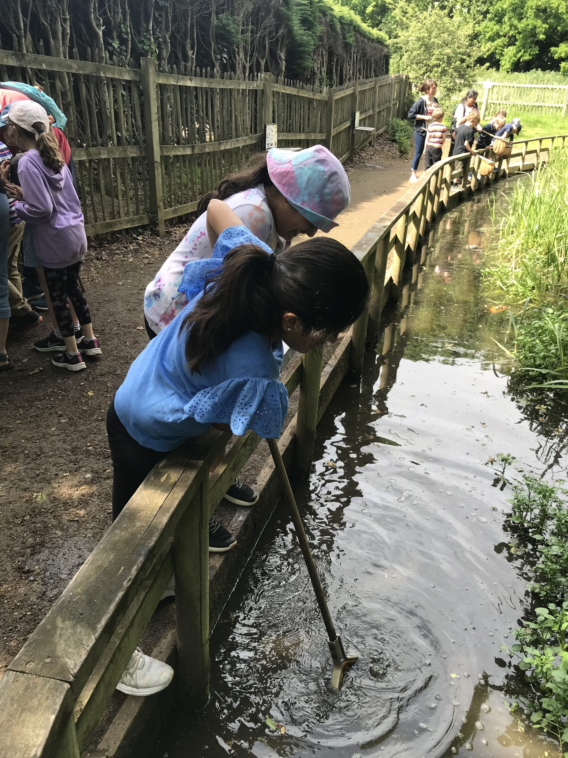
Day 1 – Nature Theme
Mini-beast hunt
Wildlife Trails
Pond dipping
Notes:
Charlotte

Slide 6
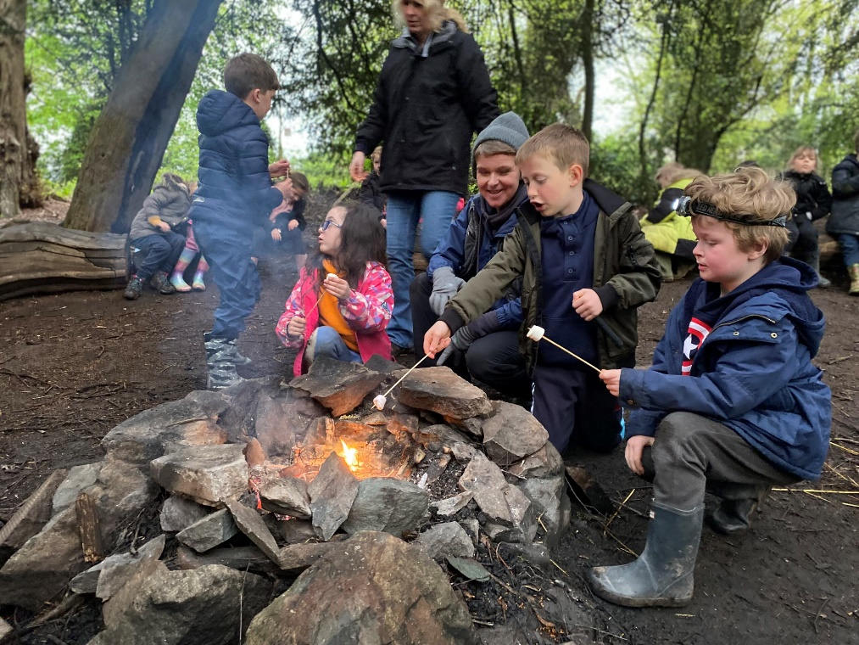
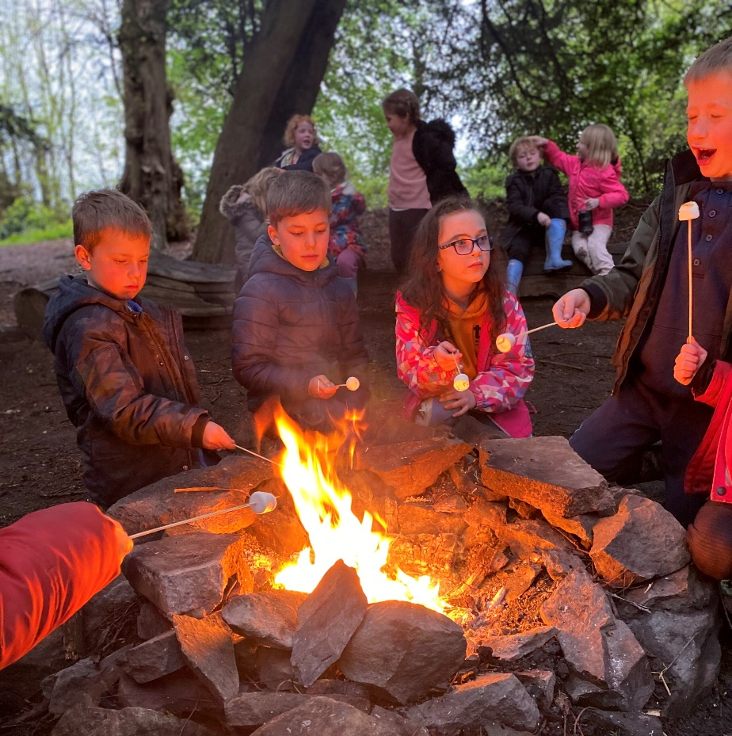
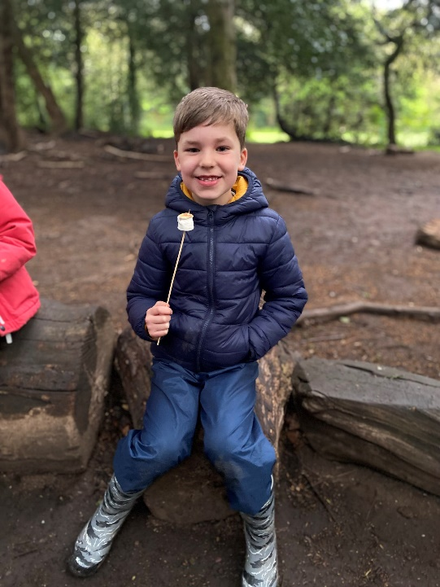
Day 1 - Evening Campfire
Notes:
Charlotte

Slide 7
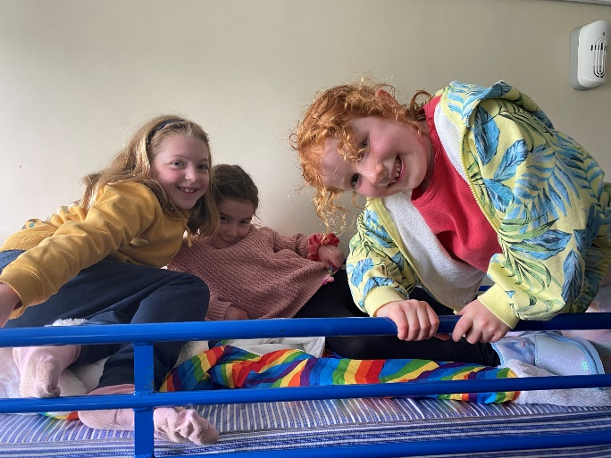
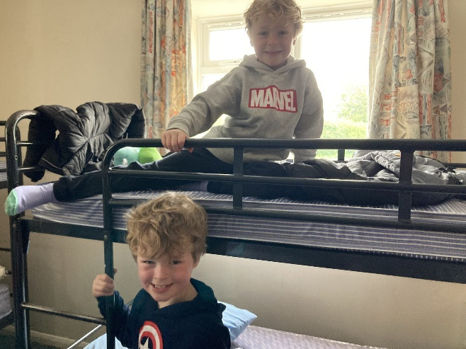
Day 1 - Bedtime
Two dormitories
Night light in the room
If children wear pull ups overnight, we make sure this is handled discretely, but please do let us know beforehand.
Bunk Beds
Notes:
Charlotte

Slide 8
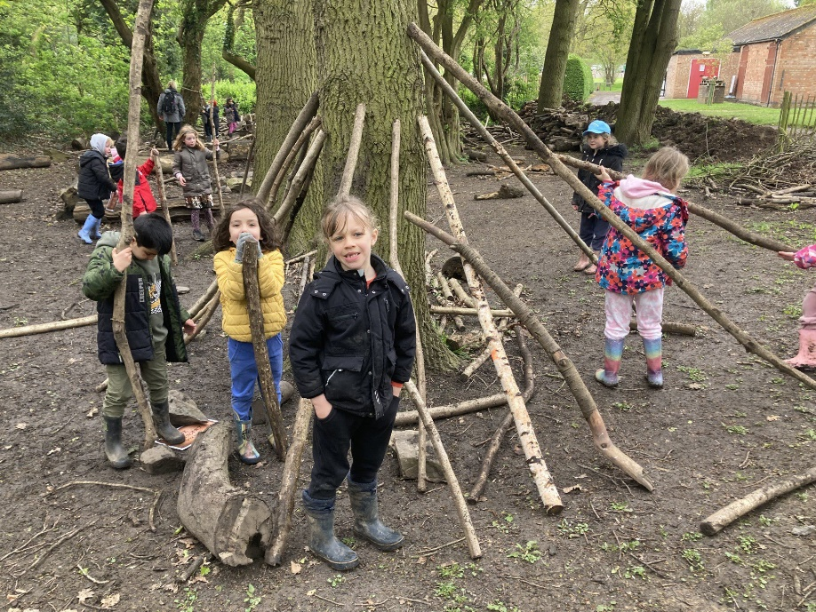
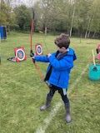
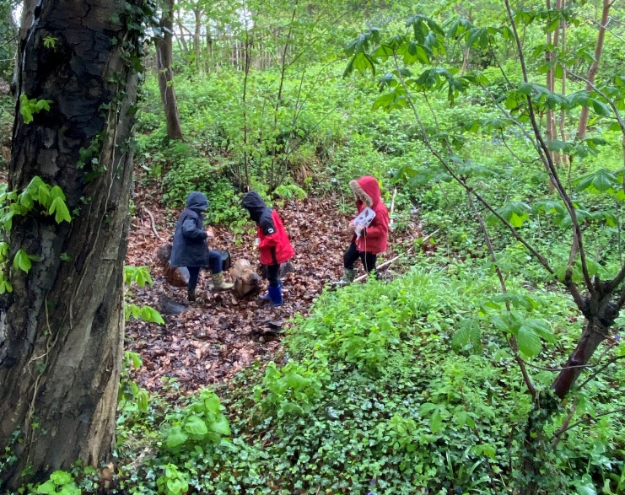
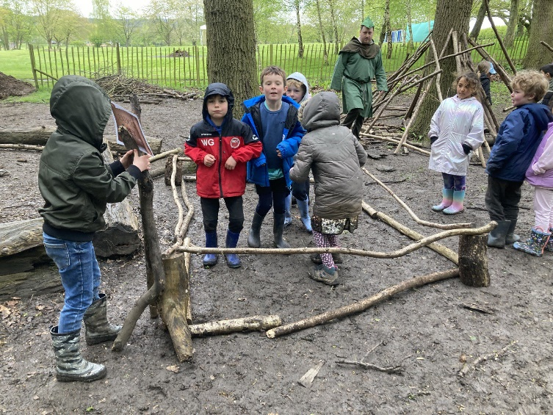
Day 2 – Robin Hood Skills
Den building
Archery
Woodland games
Notes:
Cherry

Slide 9
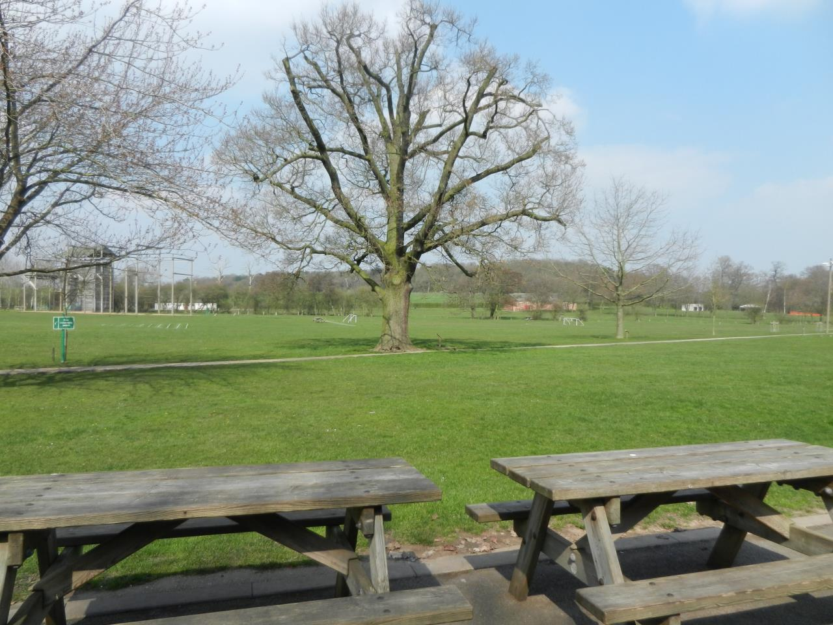
Residential Kit
General
Sleeping bag
Pillow and pillowcase
Your teddy (just one!)
Torch and spare battery
A book or game for quiet moments
A water bottle
Toothbrush
Toothpaste
Face towel
Hairbrush / bobble
Plastic bags for any wet clothes
Suncream
£5 (maximum) in change for the gift shop (optional)
Notes:
Cherry – suitcase that everything will fit in
Top Tip: pack and unpack daily

Slide 10
Residential Kit
Clothing
Tracksuit bottoms or shorts
T-shirts
Sweatshirt or fleece
Pants
Socks (for both trainers and wellies)
Pyjamas
Waterproof jacket
Sun hat
Trainers
Wellies (for nature activities)
Indoor footwear (e.g slippers)
Denim is not recommended, as the fabric holds water which is not suitable for outdoor activities.
Please don’t feel you need to buy anything new.
Old clothing is fine as the children are likely to get muddy!
Notes:
Cherry – suitcase that everything will fit in
Top Tip: pack and unpack daily

Slide 11
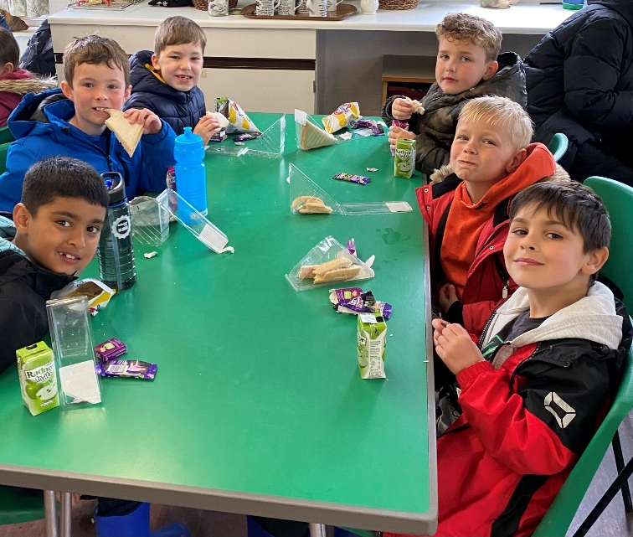

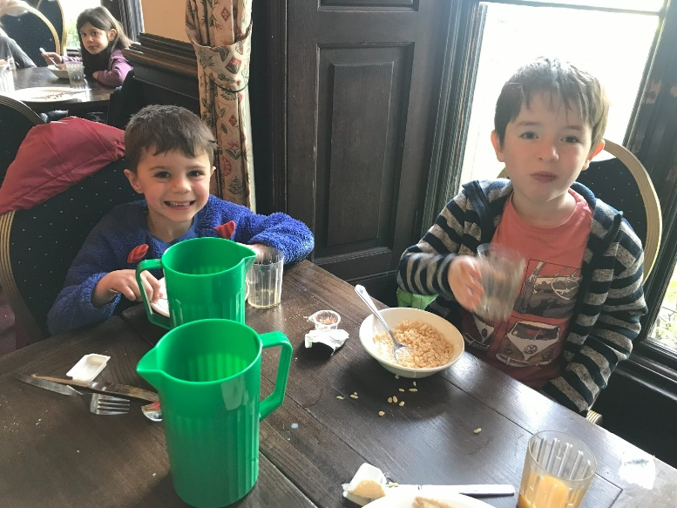
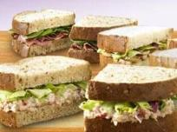
Mealtimes
Breakfast:
Cereals
Toast
Juice
Cooked breakfast
Lunch:
Sandwich
Cake
Fruit
Juice
Notes:
Cherry

Slide 12
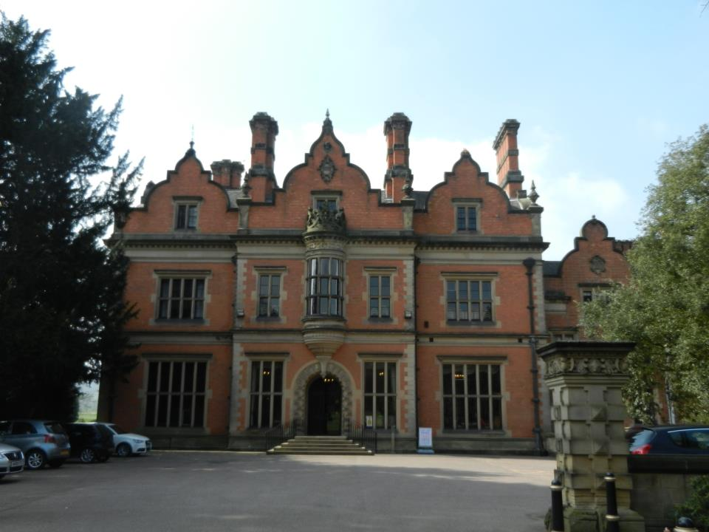
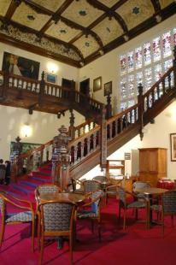
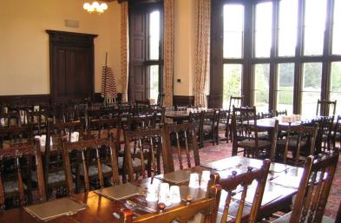
Mealtimes
Evening meal
  Sausage & Mash/veggie sausage
  Quorn Dippers/Chips
  Pizza(veggie)
  Pork Meatballs/Vegan Meatballs
  Salad bar
  Jacket Potatoes
  Sponge/Flapjack/Cookies/Ice Cream
  Yoghurts/fruit
Notes:
Cherry

Slide 13
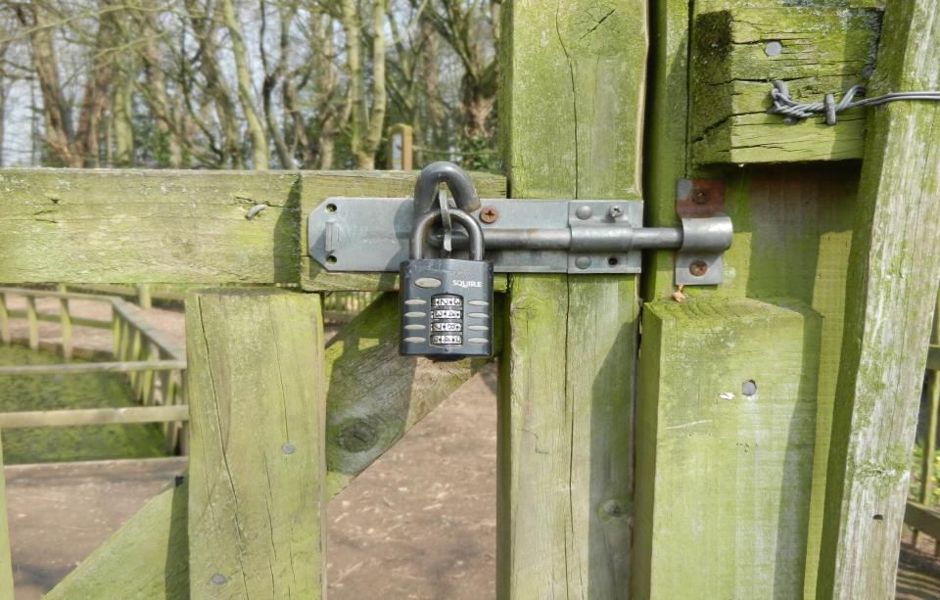

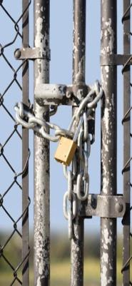
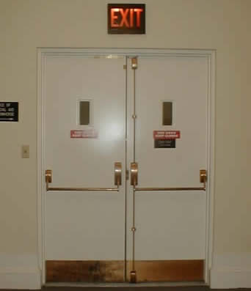
Security
Cabin doors: internal alarms
Fire doors
Windows
Private Site: Boundary fenced
Locked gate
24hrs Duty Team Member
Notes:
Cherry

Slide 14
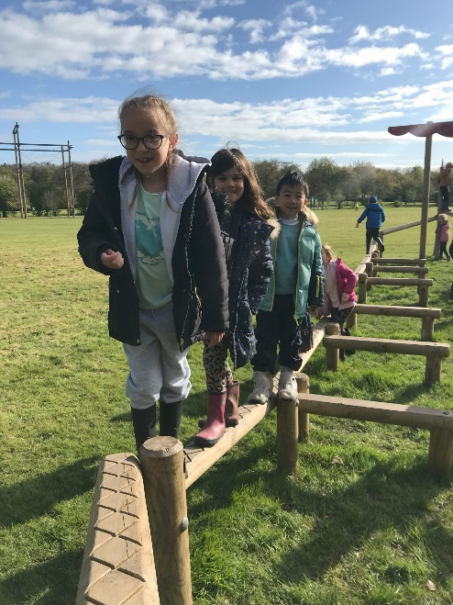


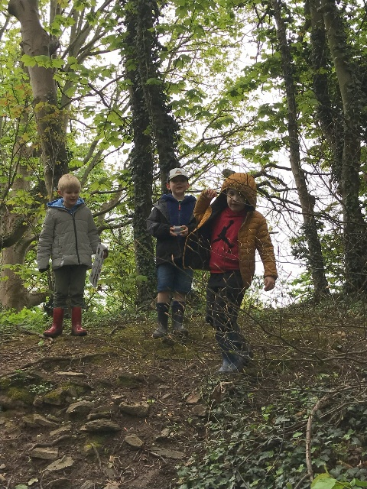
Learning Outside the Classroom experiences
    Safe
    Fun
    Investigation
    Exploration
    Journeying
    Adventure
    Residential
Notes:
Cherry
Beaumanor OLC is accredited by both the Council for Learning Outside the Classroom and AALA. All risk assessments and staff competence are scrutinised by outdoor education experts from both authorities.
OLS programmes support and develop Learning Outside of the Classroom experiences
Above else safety takes precedence.
Beaumanor should be fun and memorable from which lasting and treasured memories are taken away.
Play – during and between activities, learning how to play effectively with other people
Investigation - through the problem solving tasks they will do
Exploration – by getting to know their new surroundings, including the river during the canoeing activity
Journeying – preparing for the trip, safe behaviour on the coach to + from Beaumanor, safe behaviour on the minibus from one centre/ location to another
Adventure – through the activities
Residential – by being away from home for a few days.
They will gain a big sense of personal development on this trip.

Slide 15
Next steps
Please ensure that you have a copy of the following:
-Confidential Parental Consent Form
-Itinerary
-Kit List
Consent forms need to be returned to school by Monday.
Notes:
Cherry

Slide 16
Medication
Please write any and all medication that your child will need to take during the trip on the consent form. This includes travel sickness medicine. We will not be able to administer this if it is not included on the form.
On the day of the trip, please ensure that all medication is handed to a member of the Year 2 team. It should be in a clear, labelled bag.
Thank you!
Notes:
Cherry

Slide 17
Next steps
Payments on Arbor -
Payments can be made in instalments, with a minimum payment of £29 each time (£29 x5).
Please ensure that payment has been made in full before the residential commences.
Thank you for your payments so far.
Notes:
Cherry

Slide 18
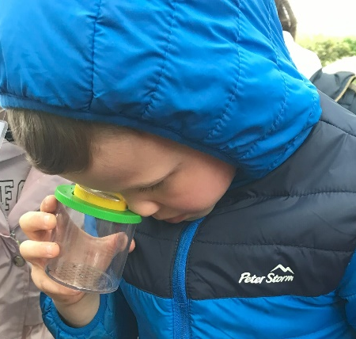
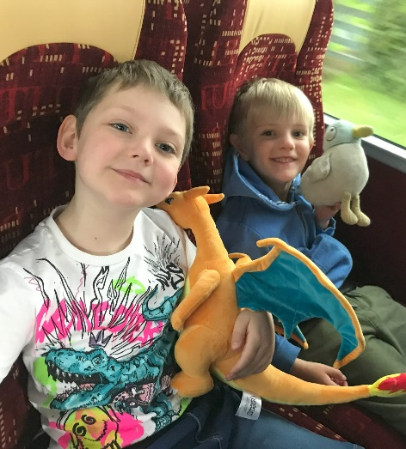
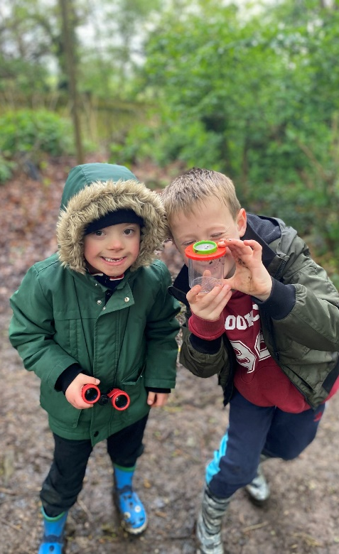
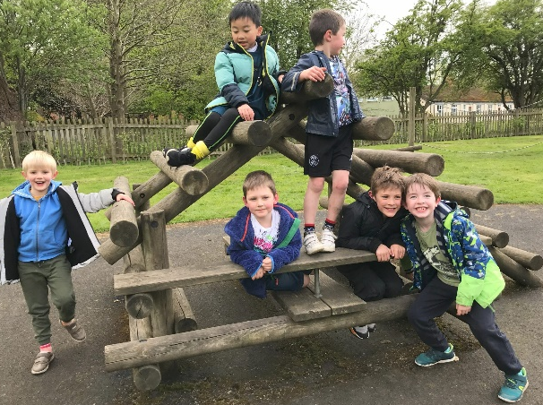
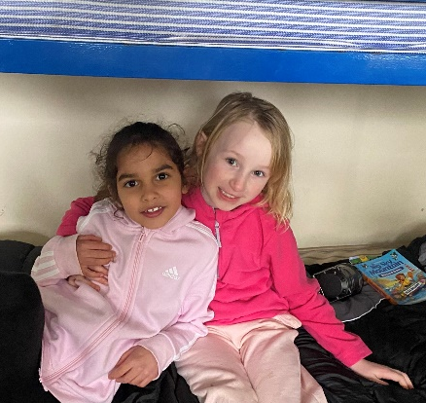
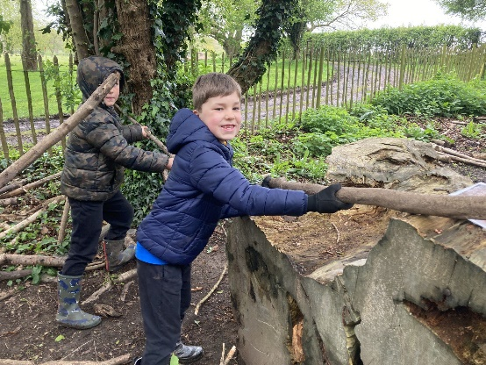
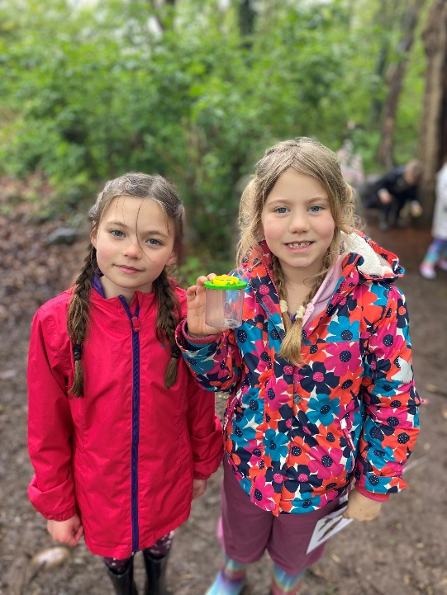
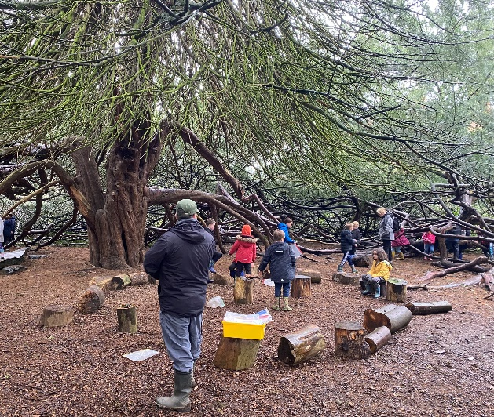
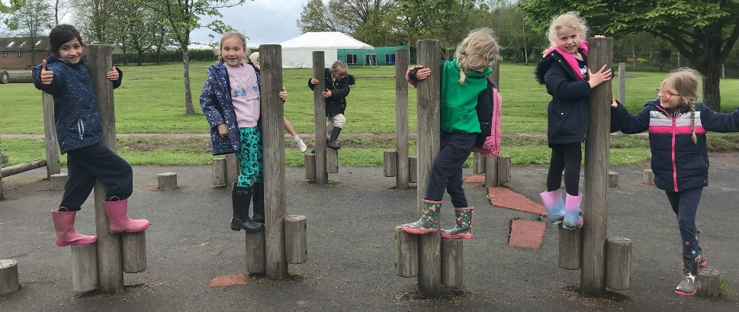
Notes:
Cherry

